Slide 1
Webinar starting shortly…
Master Class
All Roads Lead to Promotions
Notes:
Liz

Slide 2
Master Class
All Roads Lead to Promotions
Notes:
Liz

Slide 3
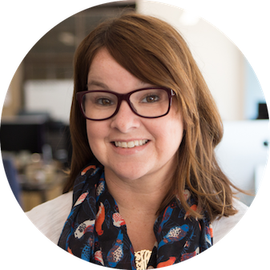
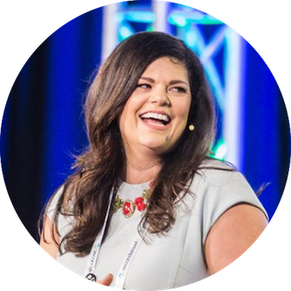
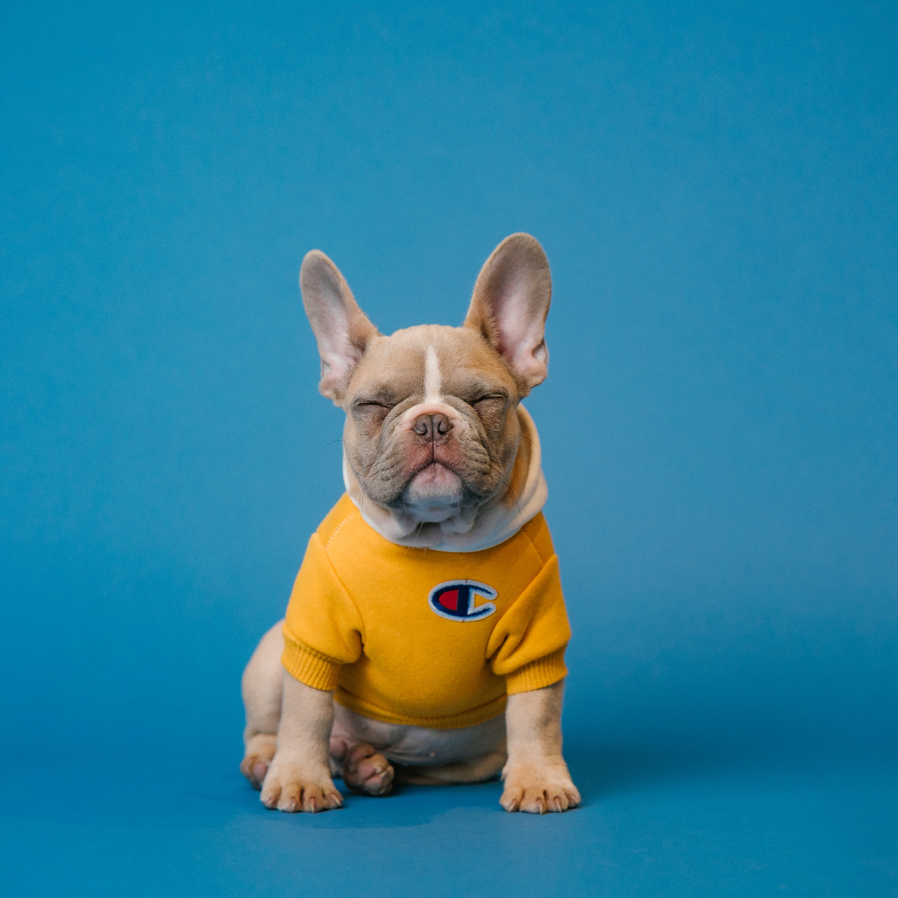
First things first…
Liz Huff
Sr. Director of Customer Success at
Upland Second Street
lhuff@uplandsoftware.com
Julie Foley
Sr. Customer Success Manager at Upland Second Street
jfoley@uplandsoftware.com
Notes:
Add GM

Slide 4
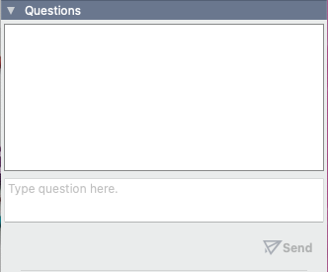
Do you have questions?
Ask in the GoToWebinar Panel during the webinar, and we will answer them at the end!

Slide 5
Audience Engagement Software
Run contests and interactive content on your websites to:
Grow your email & mobile database
Generate revenue
Engage your audience
Notes:
Second Street is an audience engagement software used by over 4,000 media companies and marketers to generate digital revenue, grow their email database, and engage their audience

Slide 6
Our Partners

Slide 7
Contests & Interactive Content
Enter to Win
Sweepstakes
Codeword Sweepstakes
Photo Contests
Video Contests
Quizzes
Personality/Outcome
Trivia
Voting
Photo Voting
Video Voting
Custom Brackets
Ballots
Best Of
Niche
Advertiser-Specific
Questionnaires
Polls
Surveys

Slide 8
The 3 Things Everyone in Media IS Focused On
What will the rest of 2023 look like?
How Second Street fits into your strategy
Today’s Agenda
Notes:
If you could only focus on three and only three activities or projects this week, and if by focusing on those three projects or activities and nothing else, it would be a successful week for you and the business, what would those three things be?

Slide 9
3 Things you are focused on
Notes:
Liz
That is what we have built this week around
Talking to you and knowing what you need

Slide 10
Revenue
Audience Engagement
First-Party Data
Notes:
Everything you do is tied to revenue

Slide 11
What will the rest of 2023 look like?
Notes:
Julie

Slide 12
Recession Warning Bells
Source: United States Census Bureau Business Formation Statistics
Copyright Borrell Inc.
Notes:
We got through the dip last time
With covid
We learned a lot
We’ve come a long way
We learned how to help our customers and local adverisers

Slide 13
During Pandemic, Larger Businesses Failed, Smaller Ones Proliferated
% change in # of locations 2019-2022
Source: 2023 Borrell Inc.
Notes:
We learned that slmaller ones dug in
Got more creative
Shift in midset as consumers – to support local businesses
That has carried on post pandemic
Investing in local has stuck with us.

Slide 14
Evidence of Strong Growth in 2023
How will your Advertising Budget change in 2023?
Source: 2023 Borrell Inc.
Notes:
Here’s the proof

Slide 15
Gap is forecasted to
start widening again
Credit: Borrell Associates
Notes:
New corey slide -

Slide 16
How Second Street fits into your strategy

Slide 17
Revenue
Audience Engagement
First-Party Data
Notes:
Everything you do is tied to revenue

Slide 18
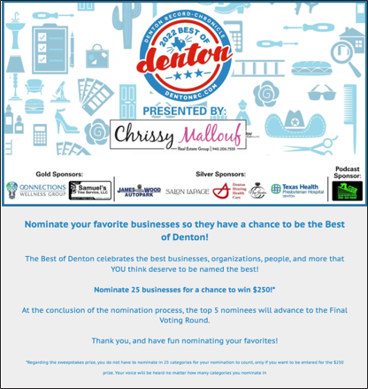
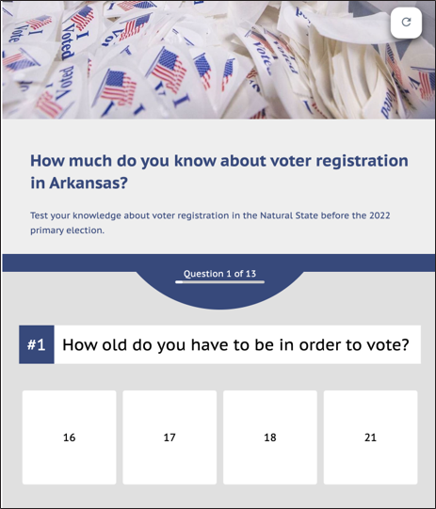
You’re already doing this!
Notes:
We aren’t asking you to take on something NEW. Not one more thing you have to do. We are a piece of what you’re already doing
Your programs like best of
Driving results for adverisers
And editorial dirinb aud engamtent

Slide 19
Revenue
Notes:
Liz

Slide 20
Keep doing what you're doing!
Sponsorships tied to current initiatives
Sellers are consultants
Set revenue goals big enough to matter!
Target the top categories and sell recurring campaigns for efficiency

Slide 21
Younger Businesses Have Far Less Marketing Expertise
Newly Established Businesses
Older Businesses
Source: 2023 Borrell Inc.
Notes:
New SMBs need your marketing advice
Younger biz need you –
Advertiser need results

Slide 22
Advertiser Results: Motorcycle Mayhem
The Leaf-Chronicle | Clarksville, TN
Great social engagement on FB and IG
263 Riders interested in a Basic Course through the Riding Academy
243 Opt Ins for newspaper
906 Opt ins for the Appleton Harley Davidson
$12,500 in Revenue
Notes:
$12.5k rev. The client is THRILLED with the results to far and excited to integrate more promotions into their overall marketing plan and events throughout the year 202 FB Visits, 157 Instagram likes, 313 Are considering trading or purchasing a Harley Davidson in the near future, 263 Interested in a Basic Riders Course/Motorcycle Course through our Appleton’s Riding Academy, 151 Signed up for Appleton Harley-Davidson's newsletter Entries - 2,091 Opt-ins for NP - 243 opt-ins for sponsor - 906

Slide 23
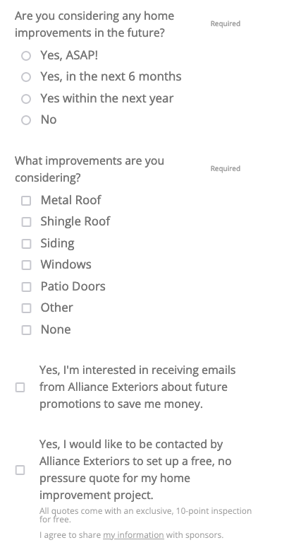
Win a new roof or windows from Alliance Exteriors!
WBYR-FM, Fort Wayne, IN
867 entries
119 opt-ins for sponsor
Closed 120K+ in new roof installations from leads
This campaign secured an annual radio campaign totaling $10,600
So successful – sponsor increased annual spend to 80+K
Notes:
When people are engaged – asking the right q's – pass it all on to the advertiser – manage expectations, ask the right questions, give away the right prize

Slide 24
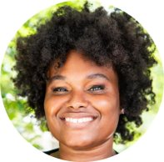
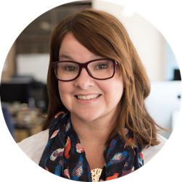
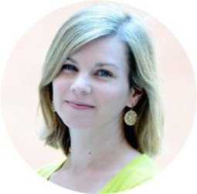
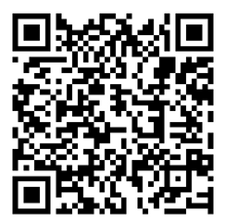
Tuesday June 13th 12:00 PM ET
Driving Measurable Results and Revenue with Promotions

Slide 25
Audience Engagement
Notes:
Julie
Not one solution and not one dept responsibility
Great for marketing to drive eyeballs
Great for sales b/c things that drive audience drive revenue

Slide 26
Stand out from the crowd!
Drive Audience & Revenue with your campaigns!
Notes:
You’re doing both

Slide 27
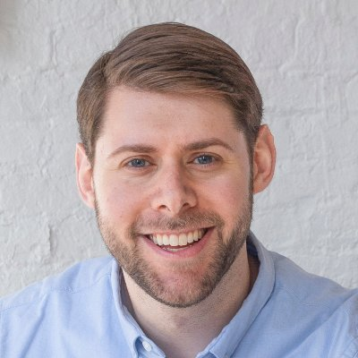
“There’s an opportunity that many newsrooms miss, a huge opportunity… engagement plus capture.”
Dan Oshinsky
Inbox Collective
Second Street Internal Data
Notes:
One side is the audience piece

Slide 28
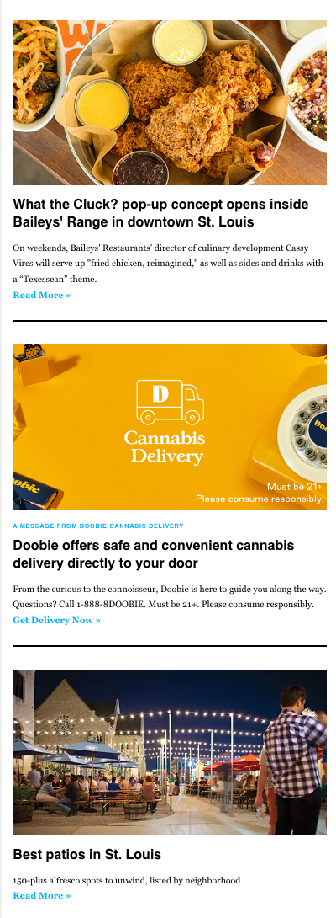
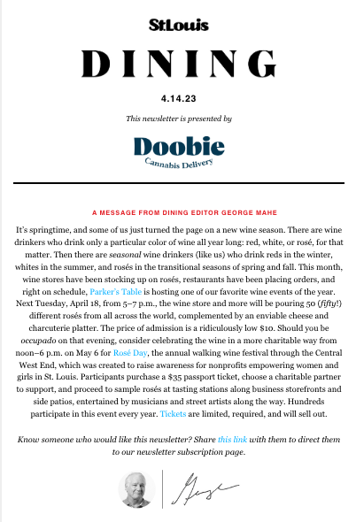
How to Engage your Audience
Choose topics:
Your audience cares about
That align with your editorial calendar or programming schedule
That are highly shareable
Ask for an opt-in!

Slide 29
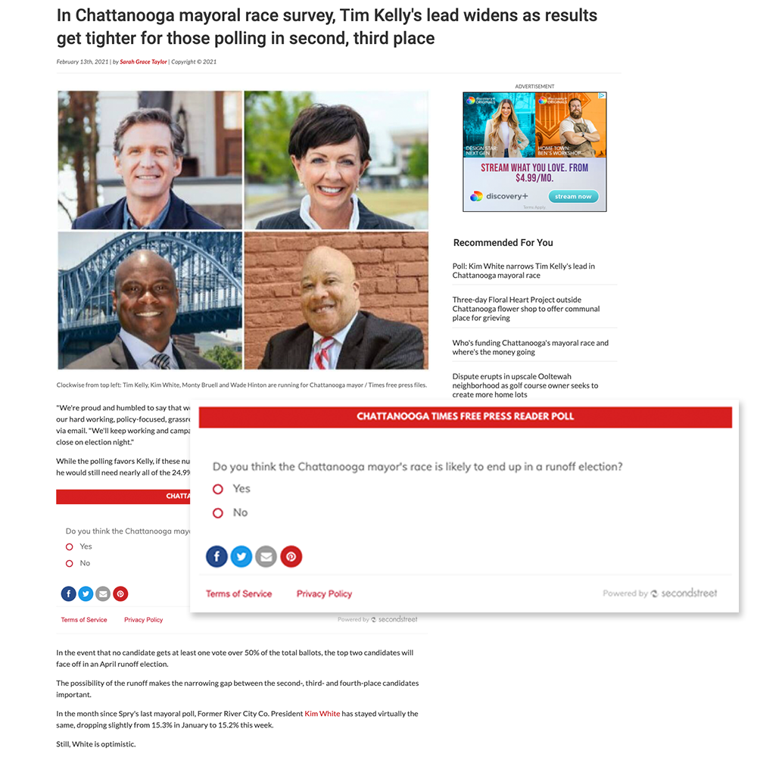
Editorial Series Polls
Chattanooga Times Free Press, Chattanooga, TN
Editorial team put one poll question a day into a top story
Over the course of the year, they’ve had:
20,800+ responses
Add thousands of new email newsletter signups
Notes:
Couple ways to get to audience engagement.
Things you already do…like editorial team running quizzes and polls ANDDDD
They experimented with what worked for them.
Watch your results and lean into what works.
They didn’t know at theh beginning of 2022 that tn football was going to be so successful and it really helped their stragegyt ot lean into quizzes and polls

Slide 30
How to Drive Revenue at the same time
Choose topics:
Mass appeal promotions and engagements
Find the right advertiser that wants these mass appeal campaigns
Run them all year long :)
Ask for an opt-in!

Slide 31
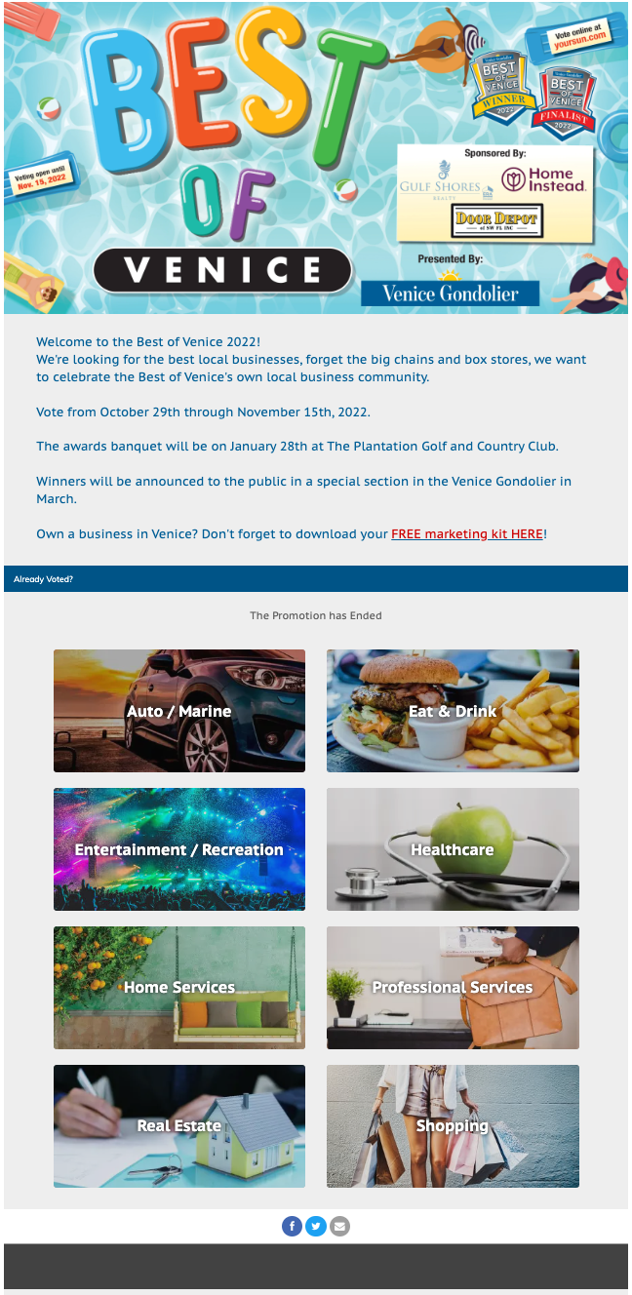
Best of Sun Coast
Sun Coast Media Group | Port Charlotte, FL
18% YOY revenue growth
15% YOY email database growth
2022 $460K
Digital only, doesn’t include ticket sales revenue
Notes:
Winner: Best of Sun Coast!
SunCoast Media Group covers 4 papers in southwest Florida with their best of program!
Revenue in 2022 was $460K! Which was 18% growth YOY!! This revenue doesn’t include event ticket sales!
They were also able to grow their email database by 15% YOY with this Best of program.
Congrats to Dave Woods and the team at Suncoast media group

Slide 32
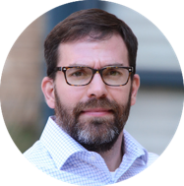
Thursday June 15th at 12:00 PM ET
Making your Best Of a Year-Round Revenue and Audience-Generating Machine

Slide 33
First-Party Data
Notes:
Liz

Slide 34
Why is it Important?
3rd Party cookies going away
Clean Data – you’re getting it straight from the source
Lowers marketing costs, increases ROI
Source: Borrell & Associates
Notes:
Provides a platform for experimentation and optimization around best practices
Helps build revenue and retention across multiple business lines

Slide 35
The local media industry stands to lose 42% of its digital ad revenue, equating to $4 billion annually by 2024.
Source: National Association of Broadcasters What the Loss of Third-Party Cookies means for Broadcasters

Slide 36
Amongst current partners:
87%
Of email database growth comes from contests & interactive content through Second Street

Slide 37
How do you use First Party Data today?
First Party Data is already part of your goals
Audience growth
Increased revenue
Higher email open rates
Notes:
LIZ

Slide 38
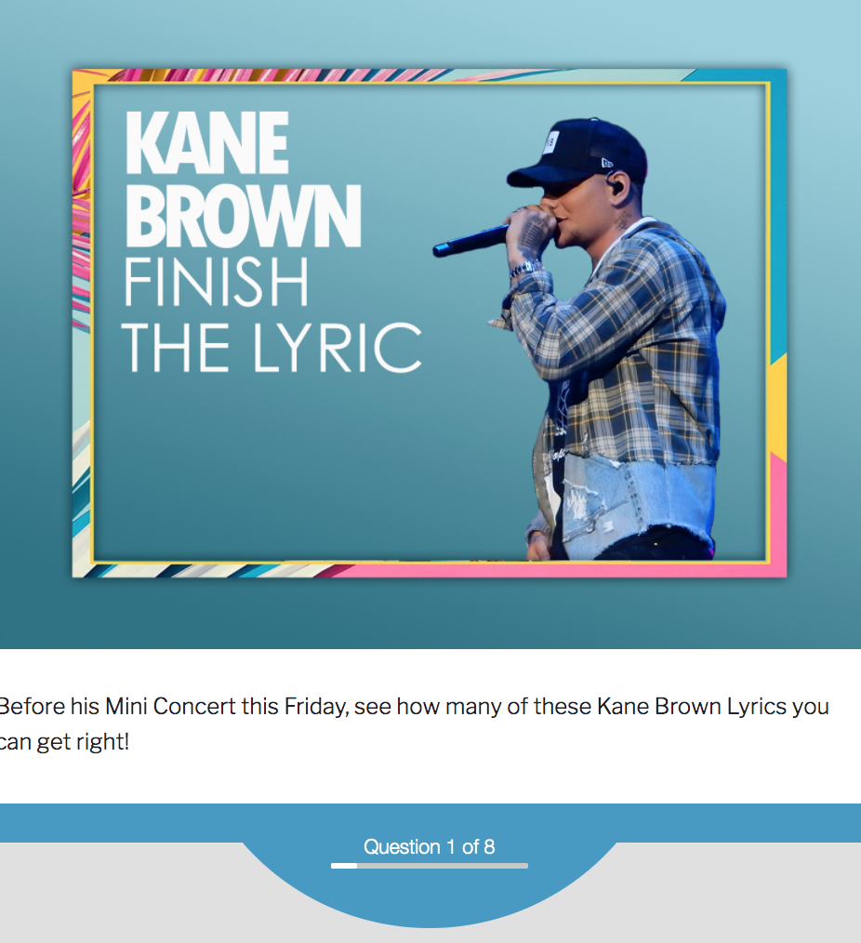
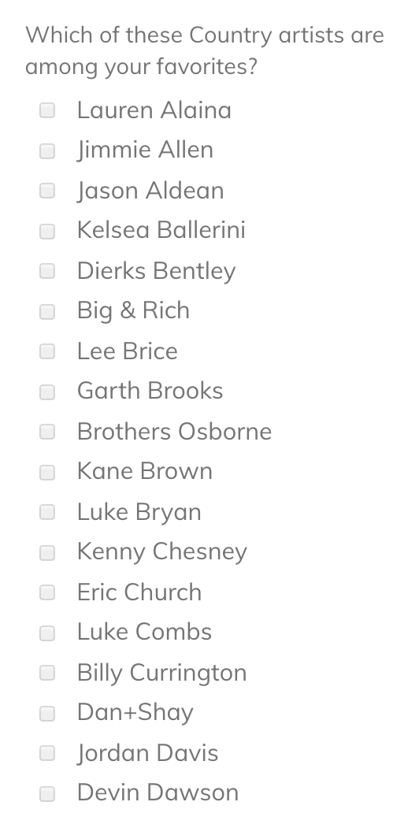
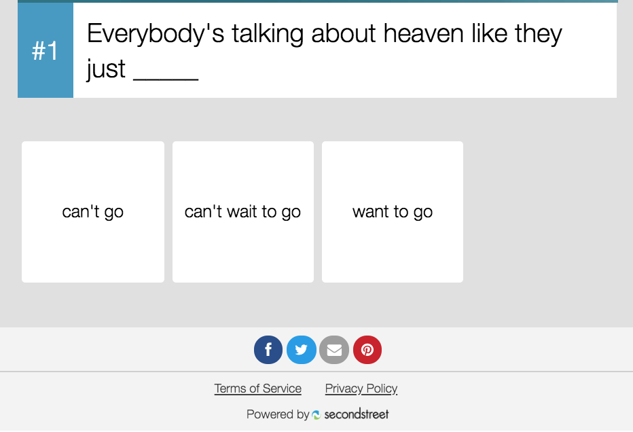
Knowing your Database
Asking for Permission AND Interests

Slide 39
Growing your Database
Wehco Media, Inc.
500,000 emails
27,000 subscription conversions
4.7%-7.7% conversion rate
LTV = $9 per email address

Slide 40
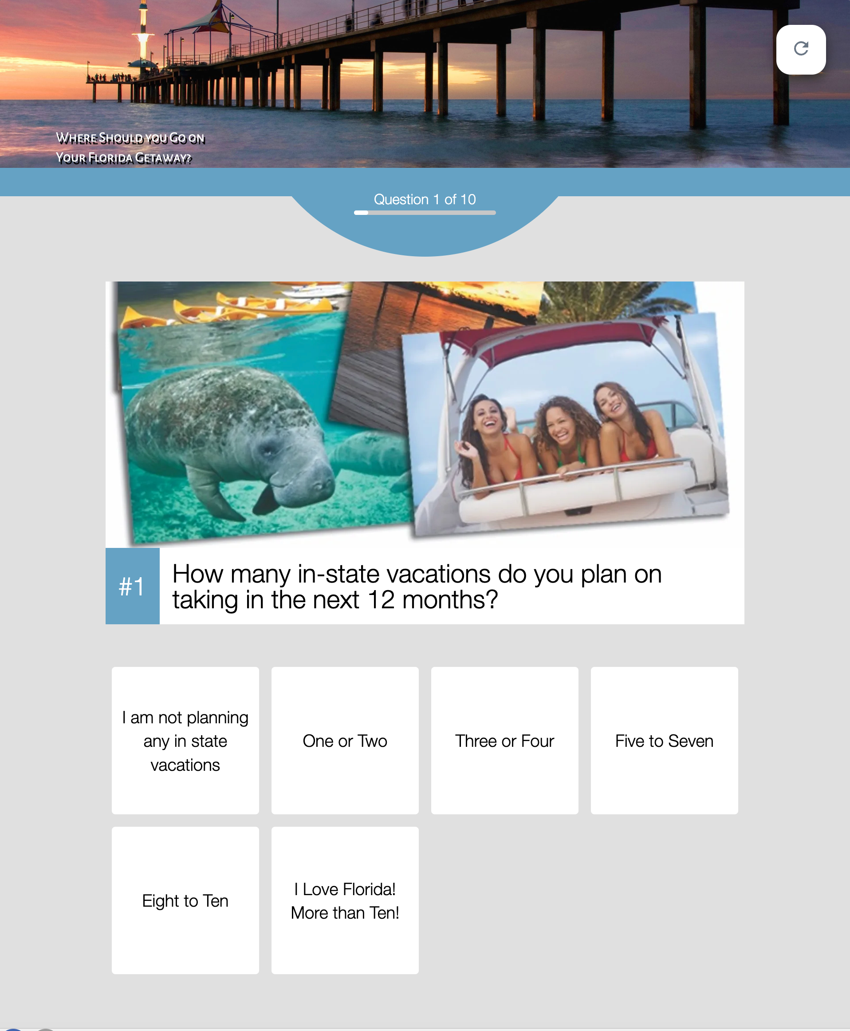
Where Should You Go on Your Florida Getaway
The Villages Daily Sun
Gathered important travel information for client
How many in-state vacations do you plan on taking in the next 12 months?
Are you interested in beach getaway packages?
When you plan "short getaways", which do you prefer?
Created media piece from travel data collected to share with travel clients and prospects
Notes:
JULIE

Slide 41
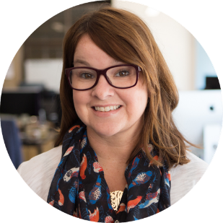
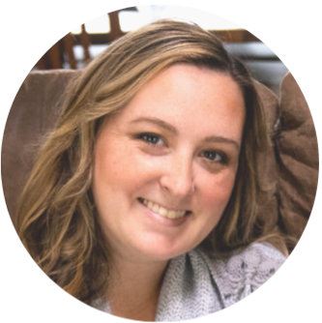
Wednesday June 14th 12:00 PM ET
Launching your First-Party Data Strategy

Slide 42
Key Takeaways
Notes:
Julie

Slide 43
Don't Forget
Buckle up for a week of great content!
Make sure you're getting everything out of your campaigns (revenue, audience, data)
This is a TEAM effort - bring in the right team!
Let us help!

Slide 44
Ideas to Get You Going
Master Class Line Up

Slide 45
Tuesday June 13th 12:00 PM ET
Driving Measurable Results and Revenue with Promotions

Slide 46
Wednesday June 14th 12:00 PM ET
Launching your First-Party Data Strategy

Slide 47
Thursday June 15th at 12:00 PM ET
Making your Best Of a Year-Round Revenue and Audience-Generating Machine

Slide 48
Q&A
Notes:
Julie

Slide 49
Resources

Slide 50
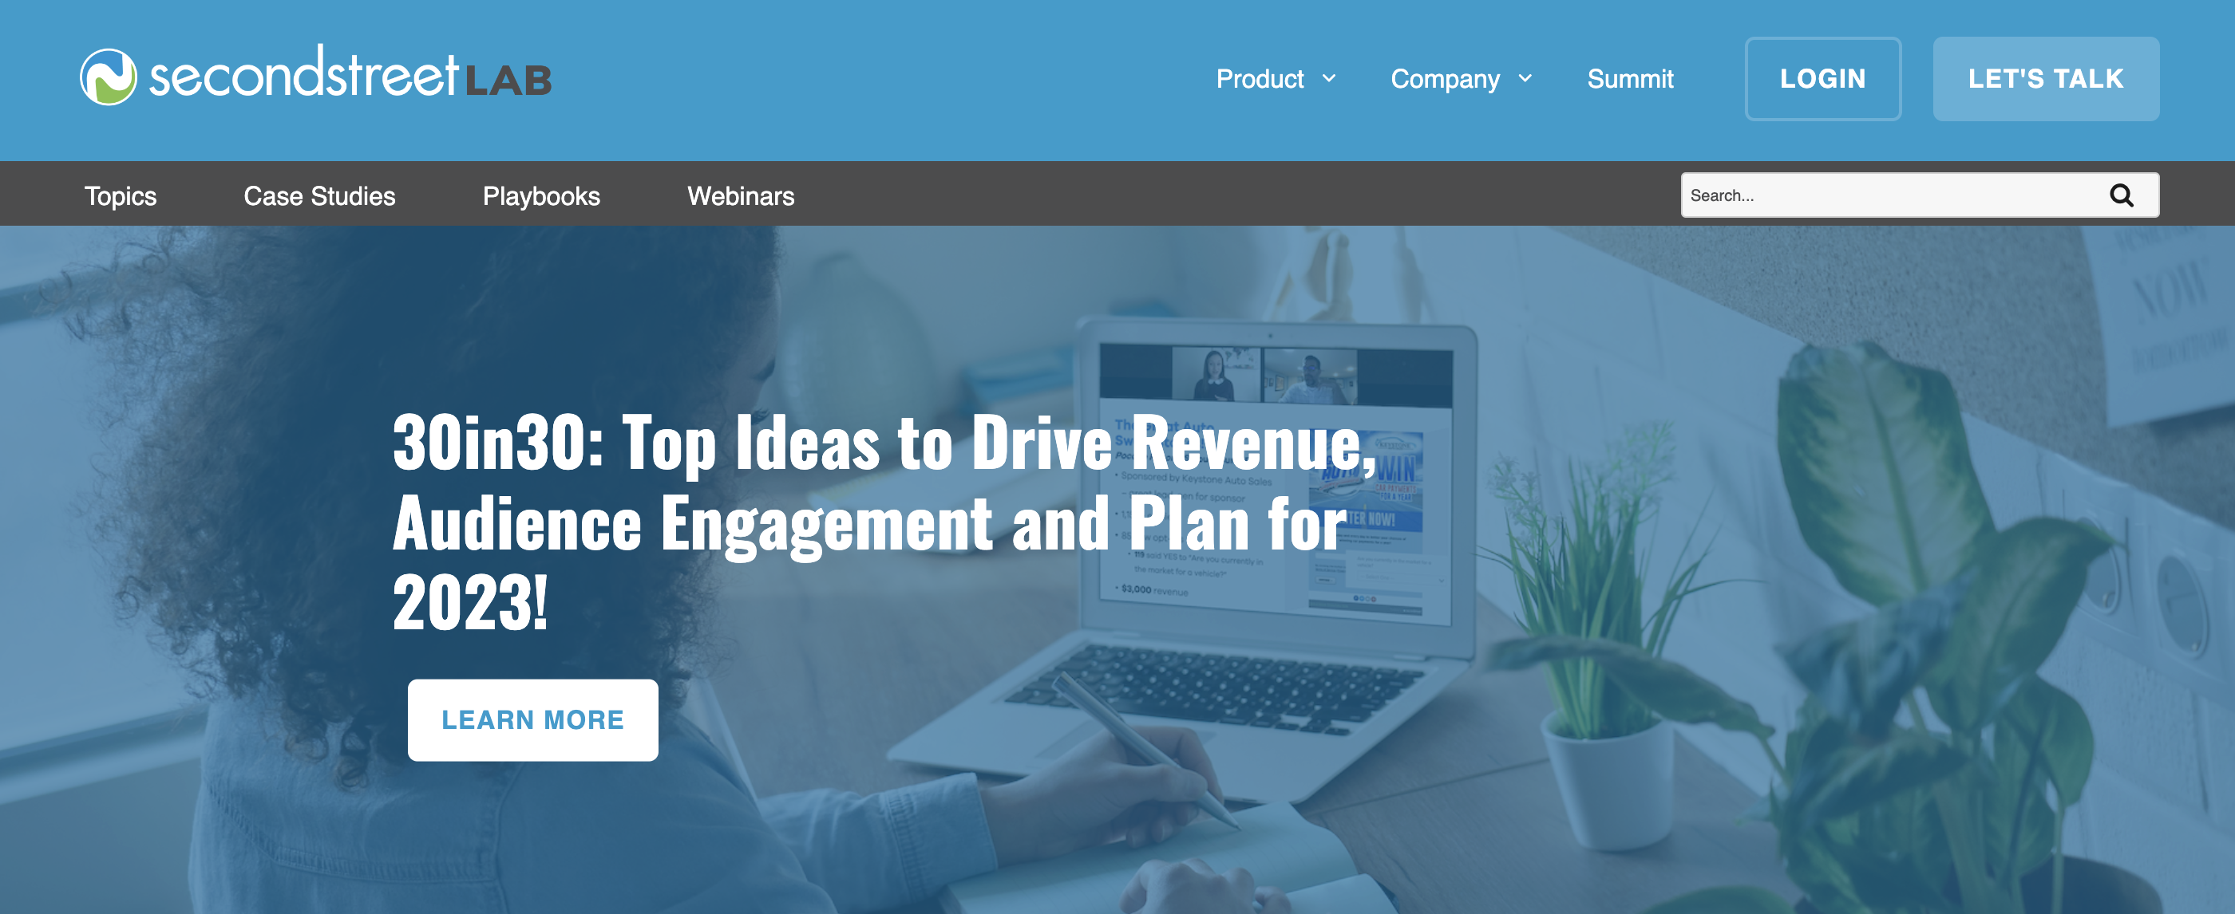
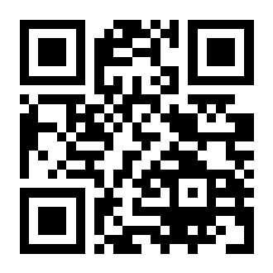
lab.secondstreet.com

Slide 51
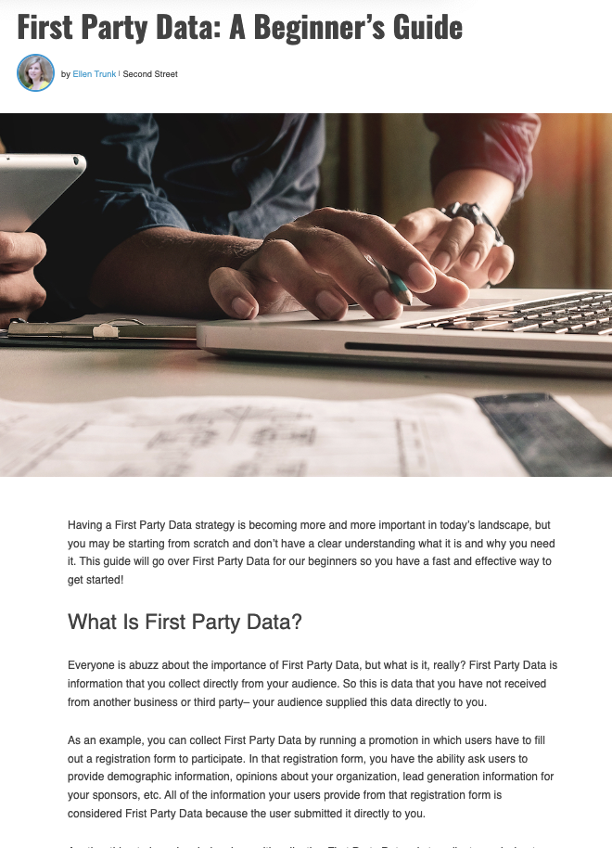
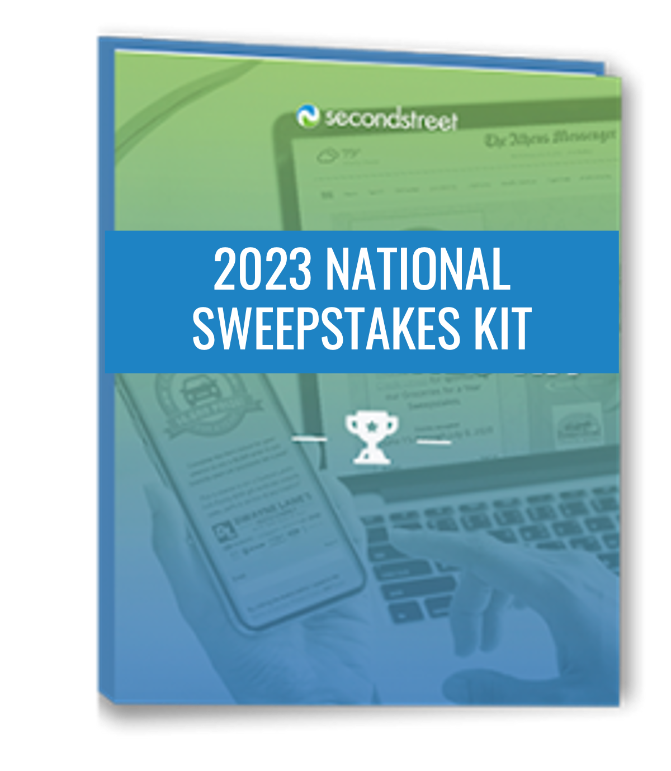
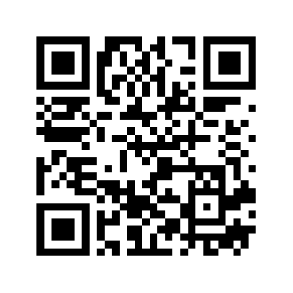
lab.secondstreet.com/playbooks

Slide 52
Thank You!
Liz Huff
Director of Customer Success at Upland Second Street
lhuff@uplandsoftware.com
Julie Foley
Sr. Customer Success Manager at Upland Second Street
jfoley@uplandsoftware.com
Notes:
Add GM

