Slide 1
How to Use This Sales One-Sheet
The following one-sheets are meant to help you sell Custom Advertiser promotions that drive qualified leads for your clients. We hope these are useful in driving revenue from advertisers that want leads and measurable results.
Promotion Name and Header Graphic
Yes you can edit the name and/or header graphic of the promotion. Or even the type (e.g. You want to do a sweepstakes instead of a photo contest).
Time Frame
We have these as 3-month packages. If you want to make these longer multi-month promotions you can do that. If you’re looking for something with a shorter time frame to align with programming or a special issue, you can do that as well.
Package
We have created packages based on media type that include digital, core and email. If you would like to edit the items in the package to reflect the inventory or capabilities of your media company, go for it!
Pricing
We have created pricing tiers based on small, mid-size and large markets. These pricing tiers are an average of what we see our partners charging for custom promotions. Feel free to adjust these pricing tiers based on your market size, media type, promotion length, unique package, and what you feel the market can bear in terms of pricing.
Prize
A suggested prize is on each one-sheet. You can adjust the prize based on what your advertiser can offer. Remember with prizes: Relevance + Value = Participation. When discussing prizes with your advertisers don’t forget to ask them about co-op dollars they may be able to acquire. That can offset the cost of pricing and prizes for them!

Slide 2
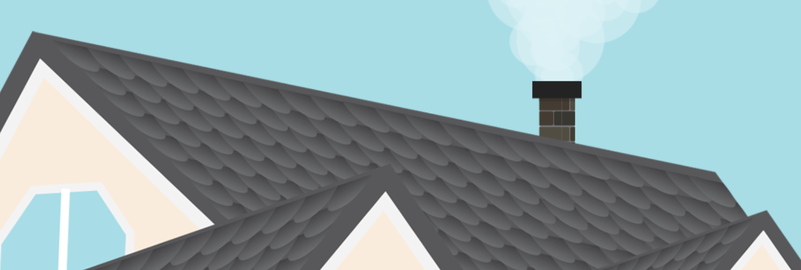
Newspaper
“Rescue My Roof” Makeover Photo Contest
3-Month Campaign
Generate leads with this 12-week multimedia campaign including print and digital ads, a lead-generating photo contest and an email campaign designed to drive the best results for your business!
BENEFITS OF BEING A SPONSOR:
Multimedia campaign to build brand awareness and engagement with your target audience
Generate qualified leads for your business
Grow your email database
Gather data on your potential customers
Drive traffic to your website
SPONSORSHIP PACKAGE:
Exclusive Sponsorship of Rescue My Roof Makeover Photo Contest
Sponsor Logo on promotional elements (print, digital, social and email) during the 12 week campaign
Digital
30K run-of-site impressions (for your business) on newspaper.com during 12-week campaign
20K run-of-site impressions to promote contest on newspaper.com during 12-week campaign
Exclusive 728x90 digital ad unit on contest page
Three lead-generation questions on the contest registration form
Digital offer/coupon on the sweepstakes thank-you page
Opt-in for your email database on the sweepstakes registration form
Optional Facebook Like box on the sweepstakes registration form
Print
Quarter-page print ad (for your business) to run once per week for 12 weeks (12 times)
Quarter-page print contest promotional ad to run once every other week for 12 weeks (6 times)
Email
Recognition on two promotional emails to our opted-in database of 30,000 (Your Email List Size goes here)
One invite email to be sent at the beginning of the campaign
One last chance email to be sent 2 days before campaign ends
Thank you email sent to everyone who enters with coupon or offer from your business
PRIZE: Roof Makeover valued at up to $10,000
RUN DATES: Three Month time frame goes here
VALUE: $XXXX
INVESTMENT: $5,000 (small market) $10,000 (mid-size market), $20,000 (large market)
000.000.0000 www.newspaperurl.com
Notes:
“Rescue My Roof” Photo Contest - Newspaper
prize: $5,000, $7,500, $10,000 (at least)

