Slide 1
Magazine

Slide 2
Best of the Best Nomination Packages
Your
Logo
Here
We are highlighting the best of the best. Our readers will nominate their favorite businesses in our community to tell us who they want to see in the voting round. To promote your business, we have created 3 promotional packages.
Important Dates:
Nomination Round: Enter Dates Here
Voting Round: Enter Dates Here
Winners Announced: Enter Dates Here
REACH OUR
BIGGEST AUDIENCE OF THE YEAR
Basic Package
Campaign runs for 4 weeks
Digital:
Sponsor 1 category on the ballot
300x 250 ad on ballot page
Print:
Quarter-page full color "nominate us ad
Deluxe Package
Campaign runs for 4 weeks
Digital:
Sponsor up to 3 categories on the ballot
300x 250 ad on ballot page
Print:
Third-page full color "nominate us" ad
Premium Package
Campaign runs for 4 weeks
Digital:
Sponsor 1 group and up to 5 categories on the ballot
300x 250 ad on ballot page
Print:
Half-page full color "nominate us" ad
Email:
"Nominate Us" ad in Daily Headlines Newsletter 1x during nomination round
Your logo on invitation email to our promotional list 1x during nomination round
INVESTMENT: $749
INVESTMENT: $1,199
INVESTMENT: $1,499
YES, I’M INTERESTED IN ADVERTISING IF I MAKE IT TO THE VOTING ROUND.
For more information, contact your Account Representative or call 000.000.0000

Slide 3
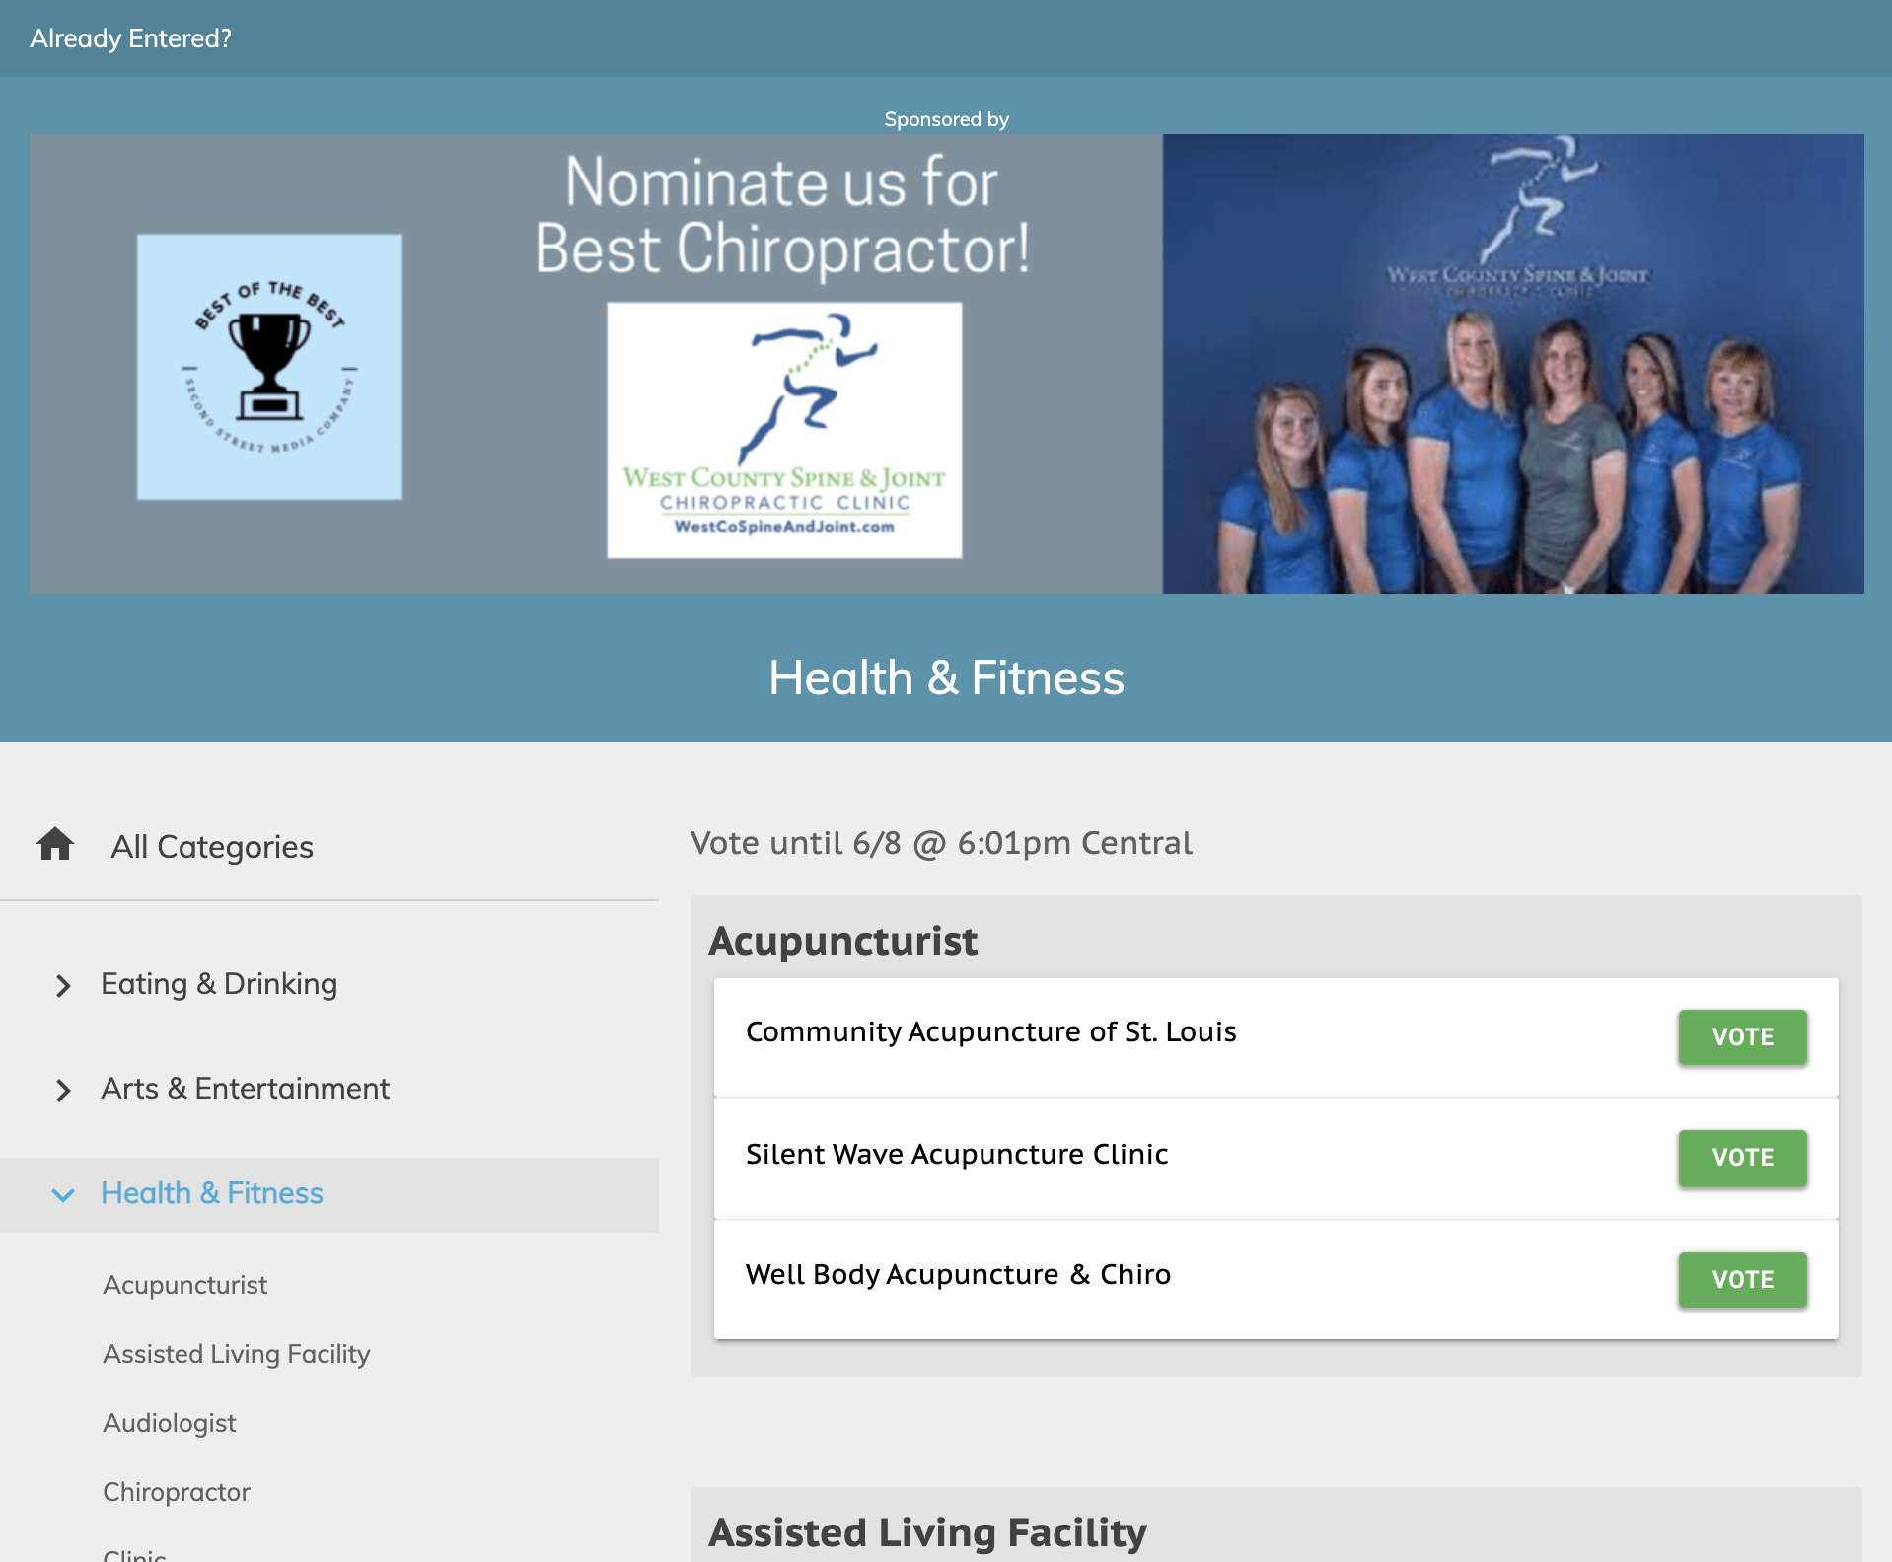
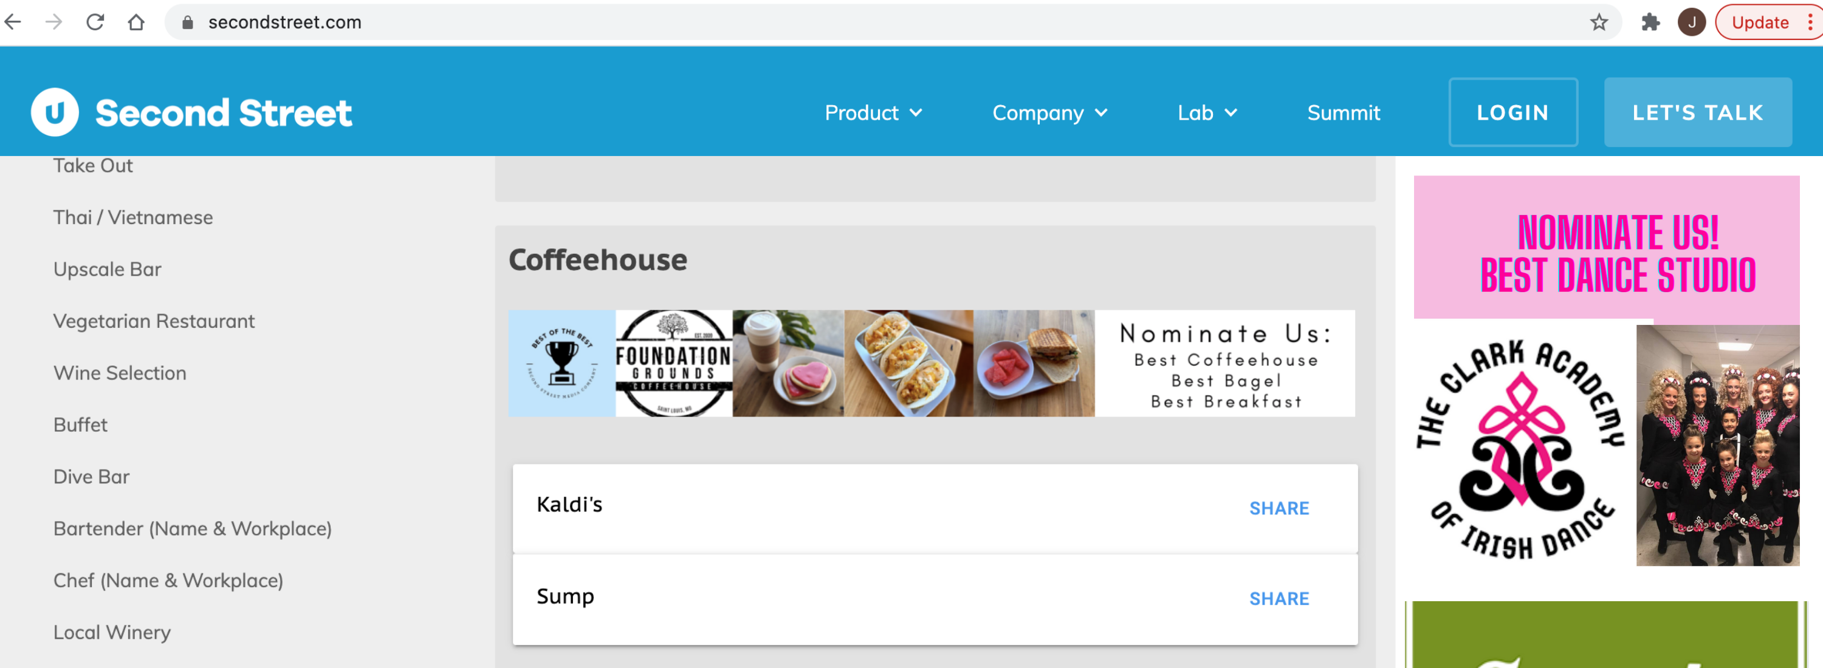
Pick Your Categories &
Campaign to Win
Arts & Entertainment
Attraction
Art Gallery
Cultural Event
Dance Club
Entertainment Venue
Family Entertainment
Festival
Fundraising Event
Live Music Event
Live Theater Group
Local Band
Local Casino
Local Event
Movie Theater
Museum
Musician
Nightclub
Outdoor Event
Place for Kids’ Birthday Party
Eating & Drinking
24-Hour Restaurant
Bagels
Bakery
Barbeque Restaurant
Bartender (Name & Place)
Bed & Breakfast
Beer Selection
Breakfast
Brunch
Buffet Restaurant
Catering
Chef (Name & Place)
Chicken Wings
Chinese Restaurant
Coffeehouse
Deli
Dive Bar
Donuts
Food Truck
French Fries
Fried Chicken
Hamburger
Happy Hour
Indian Restaurant
Italian Restaurant
Japanese Restaurant
Kid-Friendly Restaurant
Margarita
Mexican Restaurant
Romantic Restaurant
Outdoor Patio
Pizza
Seafood Restaurant
Soul Food
Sports Bar
Steakhouse
Take Out
Thai/Vietnamese Restaurant
Upscale Bar
Vegetarian Restaurant
Wine Selection
Winery
Health & Fitness
Acupuncturist
Assisted Living Facility
Audiologist
Chiropractor
Clinic
Cosmetic Dermatologist
Cosmetic Surgeon
Day Spa
Dentist
Dermatologist
Eye Clinic
Hospital
In-Home Care Elder Services
Laser Eye Center
Massage
Massage Therapist
Medical Group
Medical Spa
Orthodontist
Pediatrician
Personal Trainer
Pharmacy
Physician
Weight Loss Clinic/Counseling
Services
Accounting Firm
Auto Loan Provider
Bank
Bookkeeping/Tax Service
Car Wash
Carpet Cleaner
Child Care
Commercial Real Estate
Computer/IT Services
Construction Company
Contractor
Financial Institution
Financial Planning
Hair Salon
Heating & Air Company
Home Lighting
Home Security
Hotel
Insurance Agency
Jeweler
Kitchen & Bath Remodeler
Landscaper
Law Firm/Lawyer
Mechanic
Mortgage/Home Loan Provider
Motorcycle Shop
Nail Salon
New Home Builder
Oil Change
Pest Control
Pet Boarding/Daycare
Pet Groomer
Photographer
Piercing Studio
Plumber
Property Management Company
Real Estate Agency
Real Estate Agent
Shoe Repair Store
Tanning Salon
Tire Shop
Travel Agent
Veterinarian
Sports & Recreation
Bowling Alley
Driving Range
Golf Course
Gym
Health & Fitness Club
Local Park
Pilates Studio
Pool Hall
Shooting Range
Swimming Pool/Waterpark
Yoga Studio
Shopping
Antique Store
Appliance Store
Bicycle Shop
Book Store
Boutique
Bridal/Formal Wear
Children’s Clothing Store
Consignment Store
Department Store
Flooring/Carpet Store
Florist
Garden Store/Nursery
Gift Store
Golf Shop
Grocery Store
Health Food Store
Home Electronics Store
Home Furnishing Store
Home Improvement Store
Liquor Store
Mall/Shopping Center
Mattress Store
Men’s Clothing Store
Outdoor Outfitters
Place to Buy a Used Car
Show Store
Sporting Goods Store
Thrift Store
Toy Store
Women’s Clothing Store
Local
Church
Community Activist
Local Actor
Local Actress
Local Athlete
Local Author
Local Cause
Local Clothing Designer
Local Hero
Local Legislator
Local Radio Personality
Local Sports Team
Local Talk Show Host
Local Television Personality
Local Twitter Feed
Local Website/Blog
Neighborhood
Philanthropist
Place to Get Married
Place to Take Out of Town Guest
Place to Work
Scenic Spot
Staycation Location
Sample Ballot
1.
2.
3.
1. GROUP AD
2. CATEGORY AD
3. DIGITAL AD

Slide 4
Best of the Best Voting Packages
Your
Logo
Here
We are highlighting the best of the best. Our readers nominated their favorite businesses in our community to tell us what they wanted to see in the voting round. Now we want to see who will take the crown. To promote your business, we have created 3 promotional packages for the voting round.
Important Dates:
Nomination Round: Enter Dates Here
Voting Round: Enter Dates Here
Winners Announced: Enter Dates Here
REACH OUR
BIGGEST AUDIENCE OF THE YEAR
Basic Package
Campaign runs for 3 weeks
Digital:
Sponsor 1 category on the ballot
1 enhanced listing
300x 250 ad on ballot page
Deluxe Package
Campaign runs for 3 weeks
Digital:
Sponsor up to 5 categories on the ballot
Up to 5 enhanced listings
300x 250 ad on ballot page
Print:
Quarter-page full color ”vote for us" ad
Premium Package
Campaign runs for 3 weeks
Digital:
Sponsor 1 group and up to 5 categories on the ballot
Up to 5 enhanced listings
300x 250 ad on ballot page
Print:
Half-page full color ”vote for us" ad
Email:
"Vote for Us" ad in Daily Headlines Newsletter 1x during voting round
Your logo on "Time to Vote" email to our promotional list 1x during voting round
INVESTMENT: $999
INVESTMENT: $1,499
INVESTMENT: $1,799
For more information, contact your Account Representative or call 000.000.0000

Slide 5
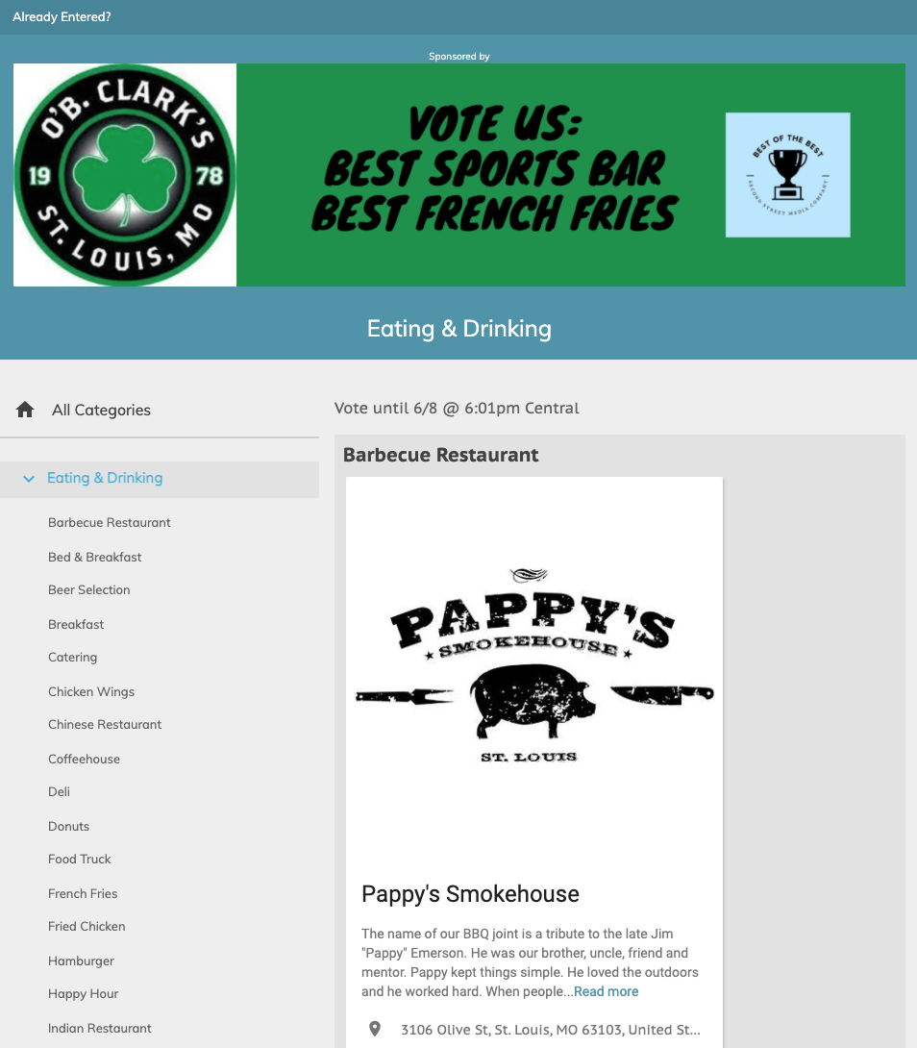
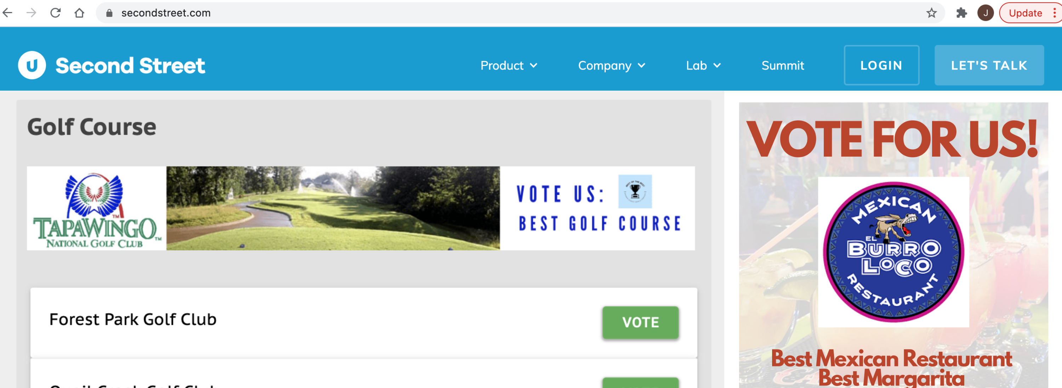
Pick Your Categories &
Campaign to Win
Arts & Entertainment
Attraction
Art Gallery
Cultural Event
Dance Club
Entertainment Venue
Family Entertainment
Festival
Fundraising Event
Live Music Event
Live Theater Group
Local Band
Local Casino
Local Event
Movie Theater
Museum
Musician
Nightclub
Outdoor Event
Place for Kids’ Birthday Party
Eating & Drinking
24-Hour Restaurant
Bagels
Bakery
Barbeque Restaurant
Bartender (Name & Place)
Bed & Breakfast
Beer Selection
Breakfast
Brunch
Buffet Restaurant
Catering
Chef (Name & Place)
Chicken Wings
Chinese Restaurant
Coffeehouse
Deli
Dive Bar
Donuts
Food Truck
French Fries
Fried Chicken
Hamburger
Happy Hour
Indian Restaurant
Italian Restaurant
Japanese Restaurant
Kid-Friendly Restaurant
Margarita
Mexican Restaurant
Romantic Restaurant
Outdoor Patio
Pizza
Seafood Restaurant
Soul Food
Sports Bar
Steakhouse
Take Out
Thai/Vietnamese Restaurant
Upscale Bar
Vegetarian Restaurant
Wine Selection
Winery
Health & Fitness
Acupuncturist
Assisted Living Facility
Audiologist
Chiropractor
Clinic
Cosmetic Dermatologist
Cosmetic Surgeon
Day Spa
Dentist
Dermatologist
Eye Clinic
Hospital
In-Home Care Elder Services
Laser Eye Center
Massage
Massage Therapist
Medical Group
Medical Spa
Orthodontist
Pediatrician
Personal Trainer
Pharmacy
Physician
Weight Loss Clinic/Counseling
Services
Accounting Firm
Auto Loan Provider
Bank
Bookkeeping/Tax Service
Car Wash
Carpet Cleaner
Child Care
Commercial Real Estate
Computer/IT Services
Construction Company
Contractor
Financial Institution
Financial Planning
Hair Salon
Heating & Air Company
Home Lighting
Home Security
Hotel
Insurance Agency
Jeweler
Kitchen & Bath Remodeler
Landscaper
Law Firm/Lawyer
Mechanic
Mortgage/Home Loan Provider
Motorcycle Shop
Nail Salon
New Home Builder
Oil Change
Pest Control
Pet Boarding/Daycare
Pet Groomer
Photographer
Piercing Studio
Plumber
Property Management Company
Real Estate Agency
Real Estate Agent
Shoe Repair Store
Tanning Salon
Tire Shop
Travel Agent
Veterinarian
Sports & Recreation
Bowling Alley
Driving Range
Golf Course
Gym
Health & Fitness Club
Local Park
Pilates Studio
Pool Hall
Shooting Range
Swimming Pool/Waterpark
Yoga Studio
Shopping
Antique Store
Appliance Store
Bicycle Shop
Book Store
Boutique
Bridal/Formal Wear
Children’s Clothing Store
Consignment Store
Department Store
Flooring/Carpet Store
Florist
Garden Store/Nursery
Gift Store
Golf Shop
Grocery Store
Health Food Store
Home Electronics Store
Home Furnishing Store
Home Improvement Store
Liquor Store
Mall/Shopping Center
Mattress Store
Men’s Clothing Store
Outdoor Outfitters
Place to Buy a Used Car
Show Store
Sporting Goods Store
Thrift Store
Toy Store
Women’s Clothing Store
Local
Church
Community Activist
Local Actor
Local Actress
Local Athlete
Local Author
Local Cause
Local Clothing Designer
Local Hero
Local Legislator
Local Radio Personality
Local Sports Team
Local Talk Show Host
Local Television Personality
Local Twitter Feed
Local Website/Blog
Neighborhood
Philanthropist
Place to Get Married
Place to Take Out of Town Guest
Place to Work
Scenic Spot
Staycation Location
Sample Ballot
1.
2.
4.
3.
1. GROUP AD
2. CATEGORY AD
3. ENHANCED LISTING
4. DIGITAL AD

Slide 6
Best of the Best Winners’ Packages
Your
Logo
Here
We are are celebrating the best of the best! Our readers nominated and voted on their favorite businesses in our community. Now we have our results, and we know what our readers think is the best of the best. To promote your business and thank our readers, we have created 3 promotional packages for the prestigious winners’ round!
Important Dates:
Winners Announced: Enter Dates Here
Winners Event: Enter Dates Here
XXX
Total Nominations
XXX
Total Votes
(Enter your totals here)
Basic Package
Digital:
Ad in 1 category in the digital Winners’ Directory
1 enhanced listing
300x 250 ad in Winners’ Directory
Print:
Quarter–page full color glossy “Thank You” ad in our special issue
Deluxe Package
Digital:
Ads in up to 3 categories in the digital Winners’ Directory
Up to 3 enhanced listings
300x 250 ad in Winners’ Directory
Print:
Half–page full color glossy “Thank You” ad in our special issue
Premium Package
Digital:
Ads in up to 5 categories in the digital Winners’ Directory
Up to 5 enhanced listings
300x 250 ad in Winners’ Directory
Print:
Full–page full color glossy “Thank You” ad in our special issue
Email:
"Thank You" ad in Daily Headlines Newsletter 1x after winners are chosen
Your logo on Winner Announcement email to our promotional list 1x after Winners are chosen
INVESTMENT: $999
INVESTMENT: $1,999
INVESTMENT: $2,499
For more information, contact your Account Representative or call 000.000.0000

Slide 7
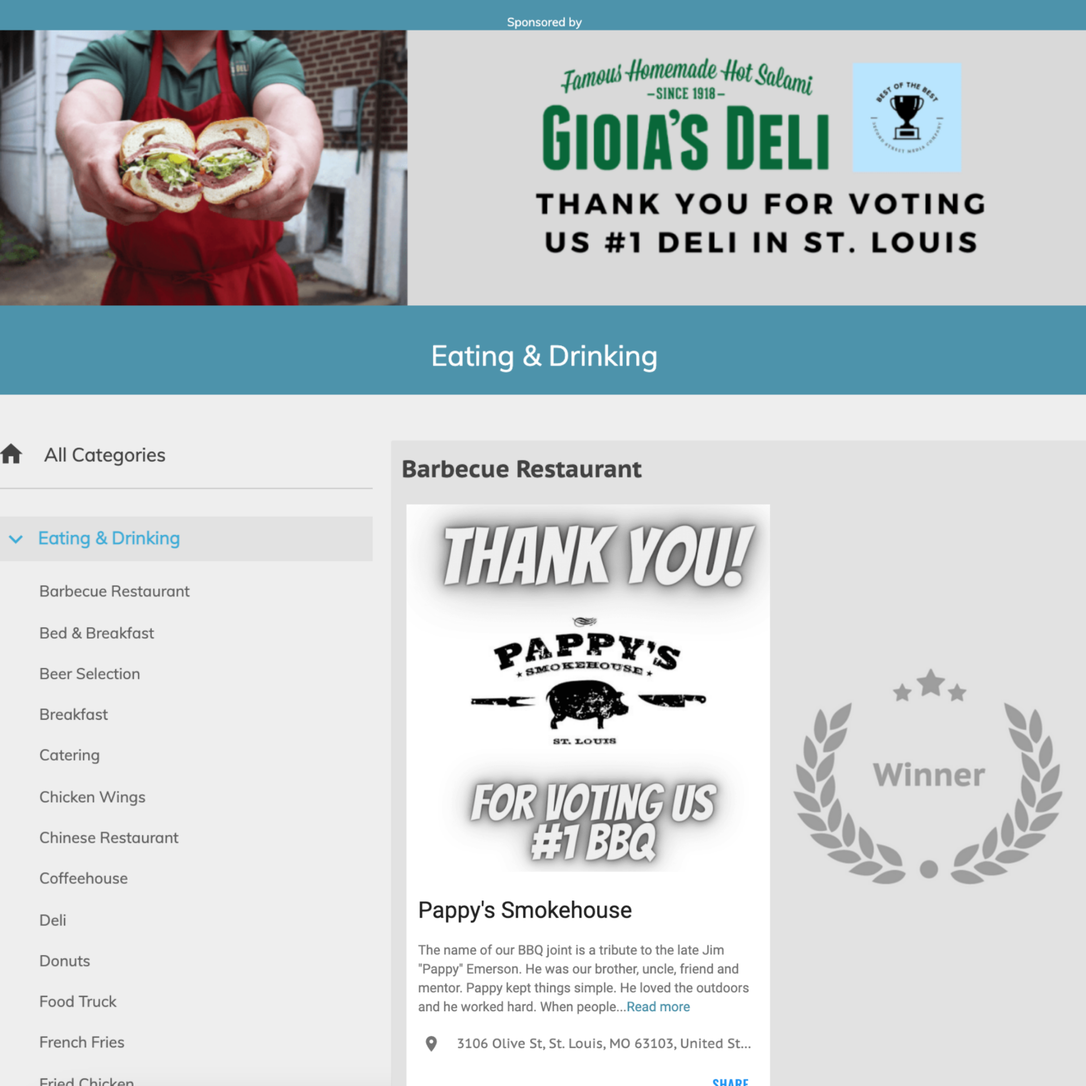
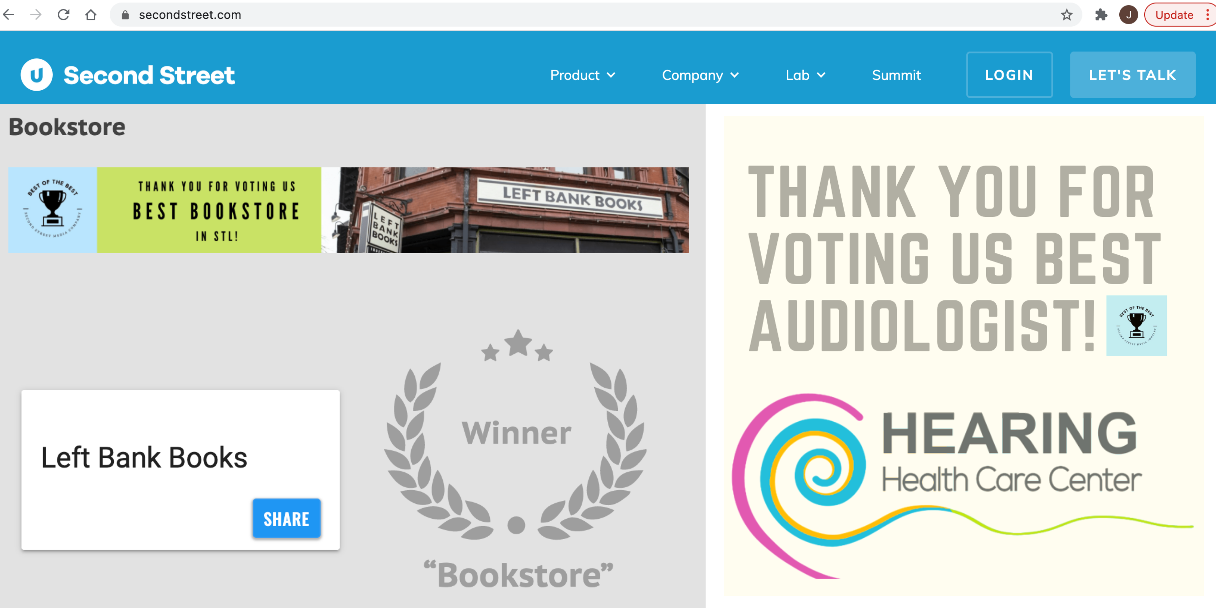
Check Out Our Categories &
Say Thank You
Arts & Entertainment
Attraction
Art Gallery
Cultural Event
Dance Club
Entertainment Venue
Family Entertainment
Festival
Fundraising Event
Live Music Event
Live Theater Group
Local Band
Local Casino
Local Event
Movie Theater
Museum
Musician
Nightclub
Outdoor Event
Place for Kids’ Birthday Party
Eating & Drinking
24-Hour Restaurant
Bagels
Bakery
Barbeque Restaurant
Bartender (Name & Place)
Bed & Breakfast
Beer Selection
Breakfast
Brunch
Buffet Restaurant
Catering
Chef (Name & Place)
Chicken Wings
Chinese Restaurant
Coffeehouse
Deli
Dive Bar
Donuts
Food Truck
French Fries
Fried Chicken
Hamburger
Happy Hour
Indian Restaurant
Italian Restaurant
Japanese Restaurant
Kid-Friendly Restaurant
Margarita
Mexican Restaurant
Romantic Restaurant
Outdoor Patio
Pizza
Seafood Restaurant
Soul Food
Sports Bar
Steakhouse
Take Out
Thai/Vietnamese Restaurant
Upscale Bar
Vegetarian Restaurant
Wine Selection
Winery
Health & Fitness
Acupuncturist
Assisted Living Facility
Audiologist
Chiropractor
Clinic
Cosmetic Dermatologist
Cosmetic Surgeon
Day Spa
Dentist
Dermatologist
Eye Clinic
Hospital
In-Home Care Elder Services
Laser Eye Center
Massage
Massage Therapist
Medical Group
Medical Spa
Orthodontist
Pediatrician
Personal Trainer
Pharmacy
Physician
Weight Loss Clinic/Counseling
Services
Accounting Firm
Auto Loan Provider
Bank
Bookkeeping/Tax Service
Car Wash
Carpet Cleaner
Child Care
Commercial Real Estate
Computer/IT Services
Construction Company
Contractor
Financial Institution
Financial Planning
Hair Salon
Heating & Air Company
Home Lighting
Home Security
Hotel
Insurance Agency
Jeweler
Kitchen & Bath Remodeler
Landscaper
Law Firm/Lawyer
Mechanic
Mortgage/Home Loan Provider
Motorcycle Shop
Nail Salon
New Home Builder
Oil Change
Pest Control
Pet Boarding/Daycare
Pet Groomer
Photographer
Piercing Studio
Plumber
Property Management Company
Real Estate Agency
Real Estate Agent
Shoe Repair Store
Tanning Salon
Tire Shop
Travel Agent
Veterinarian
Sports & Recreation
Bowling Alley
Driving Range
Golf Course
Gym
Health & Fitness Club
Local Park
Pilates Studio
Pool Hall
Shooting Range
Swimming Pool/Waterpark
Yoga Studio
Shopping
Antique Store
Appliance Store
Bicycle Shop
Book Store
Boutique
Bridal/Formal Wear
Children’s Clothing Store
Consignment Store
Department Store
Flooring/Carpet Store
Florist
Garden Store/Nursery
Gift Store
Golf Shop
Grocery Store
Health Food Store
Home Electronics Store
Home Furnishing Store
Home Improvement Store
Liquor Store
Mall/Shopping Center
Mattress Store
Men’s Clothing Store
Outdoor Outfitters
Place to Buy a Used Car
Show Store
Sporting Goods Store
Thrift Store
Toy Store
Women’s Clothing Store
Local
Church
Community Activist
Local Actor
Local Actress
Local Athlete
Local Author
Local Cause
Local Clothing Designer
Local Hero
Local Legislator
Local Radio Personality
Local Sports Team
Local Talk Show Host
Local Television Personality
Local Twitter Feed
Local Website/Blog
Neighborhood
Philanthropist
Place to Get Married
Place to Take Out of Town Guest
Place to Work
Scenic Spot
Staycation Location
1.
Sample Winners’ Directory
2.
4.
3.
1. GROUP AD
2. CATEGORY AD
3. ENHANCED LISTING
4. DIGITAL AD

