Slide 1
How to Use This Sales One-Sheet
The following one-sheets are meant to help you sell Recurring Revenue promotions that drive monthly revenue for you and qualified leads for your clients.
Promotion Name and Header Graphic
Yes you can edit the name and/or header graphic of the promotion. Or even the type (e.g. You want to do a sweepstakes instead of a photo contest).
Time Frame
We have these as 9-12 month packages. If you’re looking for something with a shorter time frame to align with programming or a special issue, you can adjust the timing of the campaign.
Package
We have created packages based on media type that include digital, core and email. If you would like to edit the items in the package to reflect the inventory or capabilities of your media company, go for it!
Pricing
We have created pricing tiers based on small, mid-size and large markets. These pricing tiers are an average of what we see our partners charging for custom promotions. Feel free to adjust these pricing tiers based on your market size, media type, promotion length, unique package, and what you feel the market can bear in terms of pricing.
Prize
A suggested prize is on each one-sheet. You can adjust the prize based on what your advertiser can offer. Remember with prizes: Relevance + Value = Participation. When discussing prizes with your advertisers don’t forget to ask them about co-op dollars they may be able to acquire. That can offset the cost of pricing and prizes for them!

Slide 2
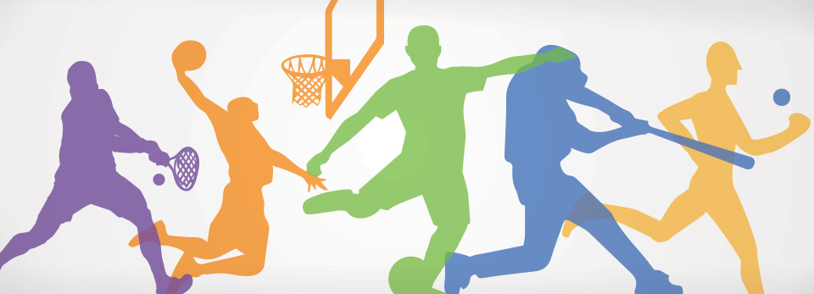
Recurring Revenue Athlete of the Month
9 Month Campaign
ADVERTISERS TO TARGET
Think about advertisers in your market that have larger budgets, want to be a part of a campaign that has a community focus and their demographic is the target audience of the theme.
Automotive
Financial
Education
Healthcare
Fast Food and Restaurant Chains
Tutoring Services
Insurance
BEST PRACTICE
Present winning athlete gift package at a pep rally or at the school with representatives from the media company and sponsor and school’s coach/Athletic Director. This is great content for an article online, in print, on-air, and social posts.
BEST PRACTICE
Educate coaches and Athletic Directors of this program prior to start and throughout the year. The more they know and actively participate, the better your program will perform. Tools you can use for this are email, letters and packets dropped off at the school.
HOW TO EXECUTE
Option 1: Seeded Entrant Voting Ballot. Sports writers nominate 3 male and 3 female athletes each month and the public votes on those seeded entrants. Athletes with the most votes each month wins.
Option 2: Two-phase ballot where your audience nominates male and female athletes each month. Top 5 nominations then move to voting round where your audience votes for the winner (Two weeks of nominations and two weeks of voting).

Slide 3
Magazine
Recurring Revenue Athlete of the Month
9 Month Campaign
Be the exclusive sponsor of this 9-Month Athlete of the Month campaign. Each month we will take nominations and then vote on top male and female Athletes. Every month can feature different products and lead-gen questions from the sponsor.
BENEFITS OF BEING A SPONSOR:
Multimedia campaign to build brand awareness and engagement with your target audience
Generate qualified leads for your business
Grow your email database
Gather data on your potential customers
Drive traffic to your website
SPONSORSHIP PACKAGE:
Exclusive sponsorship of Athlete of the Month campaign.
Sponsor logo on promotional elements (print, digital, social, and email) during the 9-Month campaign
Digital
25K run-of-site impressions each month to promote contest on magazine.com
Exclusive 728x90 digital ad unit on contest page
One unique lead-generation question on the contest registration form each month
Digital offer/coupon on the sweepstakes thank-you page
Opt-in for your email database on the sweepstakes registration form each month
Optional Facebook Like box on the sweepstakes registration form each month
Print
Full page Print Ad to run once per month (9 times total)
Half-page Print contest promotional ad to run once per month (9 times total)
Email
Recognition on 9 promotional emails to our opted-in database of 30,000 (Your Email List Size goes here)
One invite email to be sent at the beginning of each month of the campaign
Thank you email sent to everyone who enters with coupon or offer from your business
PRIZE: Monthly Gift Card for Athletes Valued at $XXX Per Month for 9 Months (optional)
RUN DATES: August - May
EXCLUSIVE SPONSOR VALUE: $X,XXX a month (9-month sponsorship package)
INVESTMENT: $1,500/month (small market) $3,000/month (mid-size market), $7,500/month (large market)
000.000.0000 www.magazine.com

