Slide 1
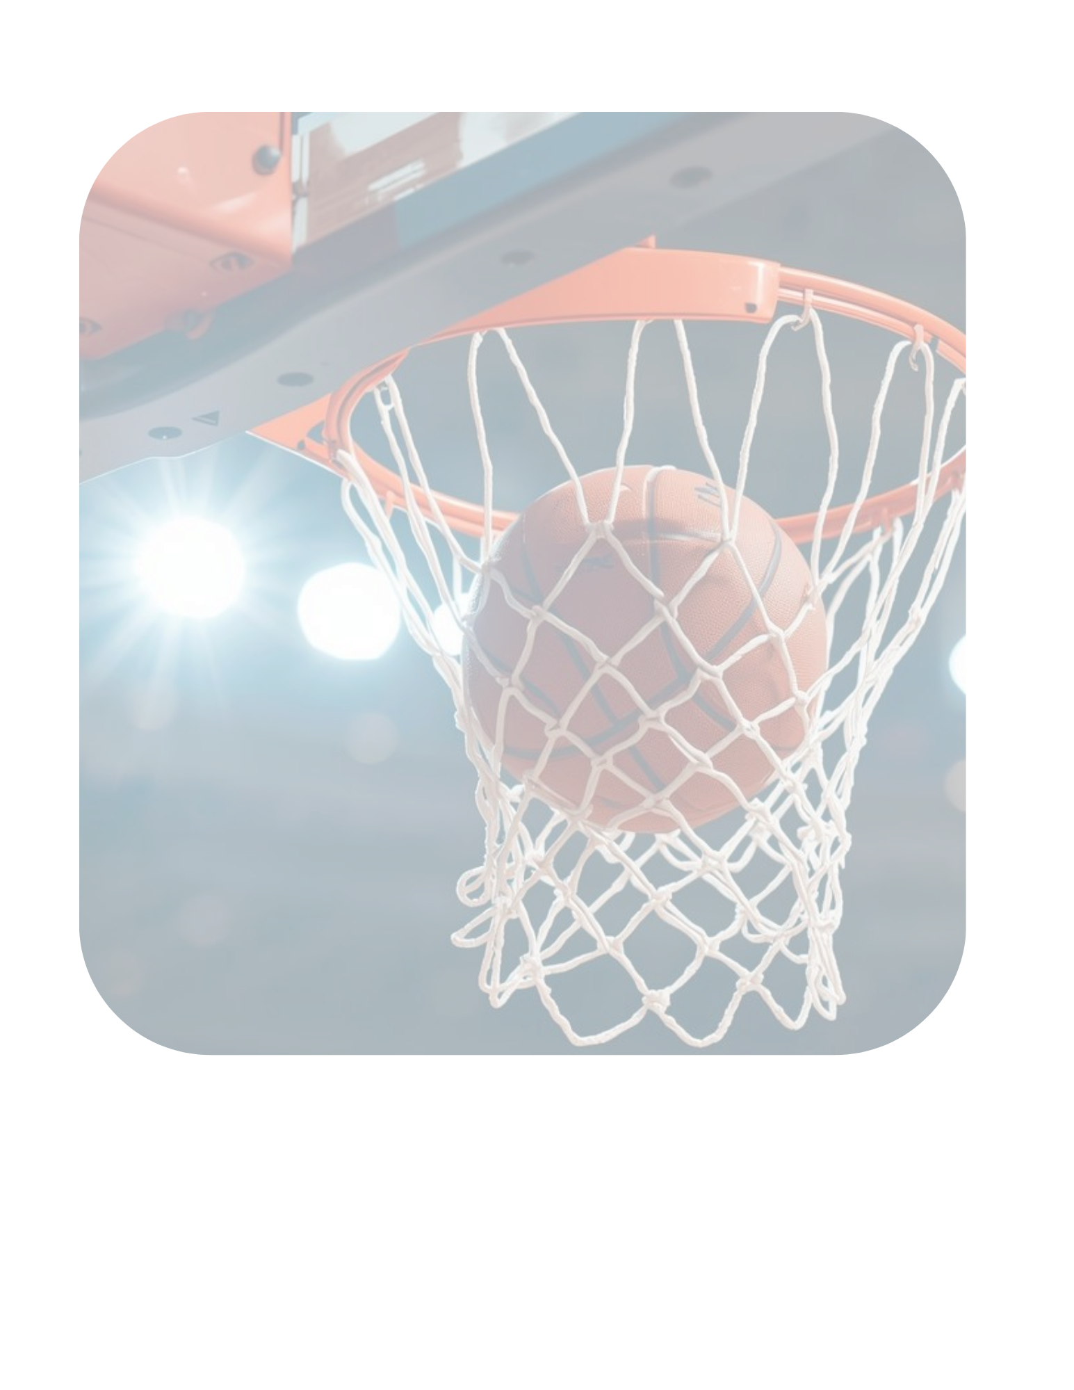

(Client Name)
Real Results:
Leads, Data, Revenue

Slide 2
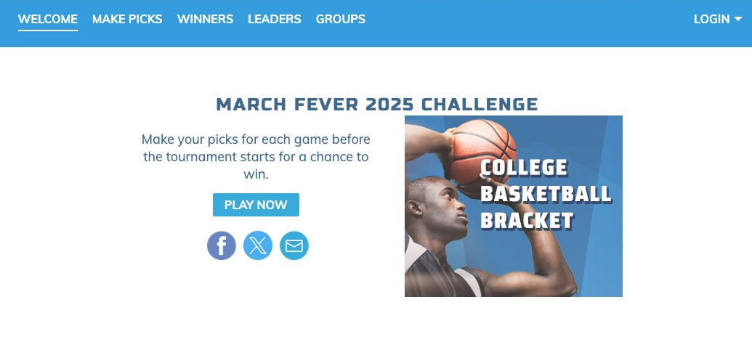
Turn Engagement into Actionable Leads with National Sports Promotions
Notes:
Fun and engaging for your audience
Interactive
Captures attention
Motivates participation
Gives you permission to market in the future
Backed up with a customized, multi-media advertising package
HOw: A multimedia campaign, centered around an online promotion to drive actionable leads.
Benefits of running a promotion?
An online contest works really well for building actionable leads with email growth because it does three things at once: it captures attention, motivates participation, and gives you permission to market long-term.
Why Online Contests Are a Powerful Lead Builder
Running an online contest is one of the fastest and most effective ways to grow an email database with leads that are ready to act. Here’s why:
Drives Big Participation
People love the chance to win. A great prize instantly gets attention and motivates thousands to enter, giving your brand a huge audience boost.
Collects Real, Actionable Leads
Every entry requires an email address, so you’re not just reaching people once—you’re building a list of potential customers you can market to again and again.
Captures More Than Just Emails
You can ask custom questions that uncover interests, preferences, and buying intent. That means the leads you collect aren’t just names on a list—they’re actionable insights you can use to target future campaigns.
Built-In Word of Mouth
Contests are naturally shareable. When participants spread the word for extra chances to win, your reach multiplies without added cost.
Immediate Impact + Long-Term Value
The contest creates buzz and traffic now, while the email list you build becomes a long-term marketing asset that drives sales well beyond the promotion.
Bottom line: An online contest doesn’t just get attention—it turns that attention into leads you can use to grow revenue.
“An online contest is one of the easiest ways to build a list of people who actually want to hear from you. The prize grabs attention, the entry form collects email addresses and insights about your audience, and the built-in sharing drives viral reach. The best part? You’re not just getting names—you’re building an email list you can market to over and over again, turning one promotion into a long-term revenue driver.”

Slide 3
The Challenge for Advertisers
You need a way to grow email lists with people who actually want to hear from you
Audiences are inundated by traditional advertising that doesn't promote real interaction
Traditional
sign-up forms are boring and low-converting
You need measurable ROI and long-term value

Slide 4
The Solution
National Sports Contests
That drive actionable engagement
Include
prizes that create excitement and participation
Provides built-in sharing that drives viral reach
The fastest and easiest way to build a powerful email list
Supported by a multi-media marketing campaign

Slide 5
Benefits of National Sports Contests
Huge event with national audience
Drives real leads for ROI
National prizes bring BIG participation
Community involvement
Large brand exposure
Opt-ins for your business to grow YOUR database
Foot traffic from coupons in Thank You Email
Robust promotions campaign to drive entries & keep your brand front and center
Opportunity to gather consumer data
Opportunity to include local prizes to promote your products and/or services
Notes:
Why Online Contests Are a Powerful Lead Builder
Running an online contest is one of the fastest and most effective ways to grow an email database with leads that are ready to act. Here’s why:
Drives Big Participation
People love the chance to win. A great prize instantly gets attention and motivates thousands to enter, giving your brand a huge audience boost.
Collects Real, Actionable Leads
Every entry requires an email address, so you’re not just reaching people once—you’re building a list of potential customers you can market to again and again.
Captures More Than Just Emails
You can ask custom questions that uncover interests, preferences, and buying intent. That means the leads you collect aren’t just names on a list—they’re actionable insights you can use to target future campaigns.
Built-In Word of Mouth
Contests are naturally shareable. When participants spread the word for extra chances to win, your reach multiplies without added cost.
Immediate Impact + Long-Term Value
The contest creates buzz and traffic now, while the email list you build becomes a long-term marketing asset that drives sales well beyond the promotion.
Bottom line: An online contest doesn’t just get attention—it turns that attention into leads you can use to grow revenue.

Slide 6
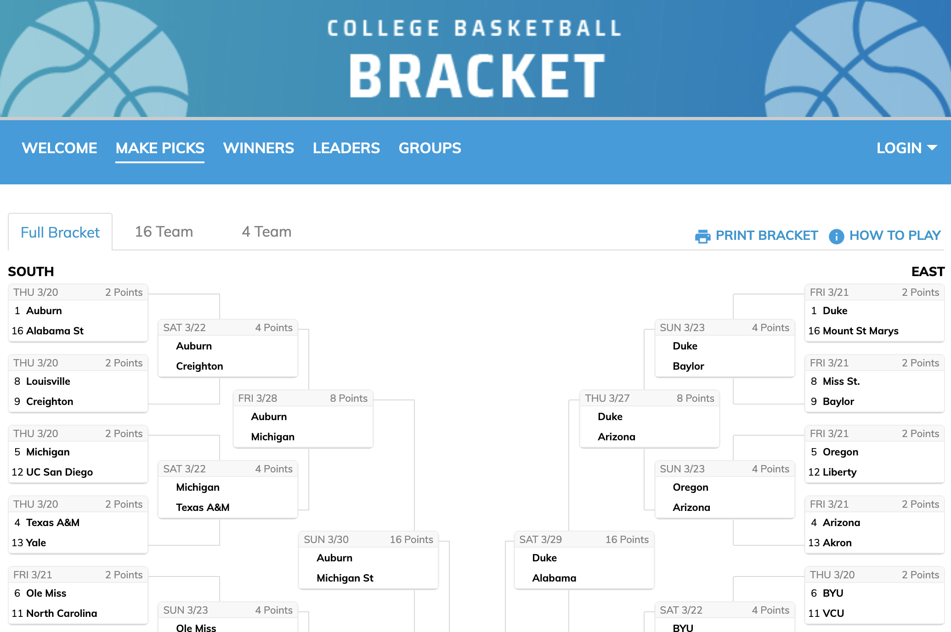
What is it
A Prediction Bracket where users select the team that they predict will win each game of the Men's College Basketball Tournament and enter the score for the designated tie-breaker game.
Users may enter their picks until the scheduled tip-off of the first game of the First Round of the tournament. Users will not be required to pick the winners of the four play-in games.
There are 3 brackets available for play:
The 64-team upfront bracket that must be completed before the first game of the tournament.
The 16-team bracket where users can come back and re-pick for the sweet 16.
The 4-team bracket where users can come back and re-pick for the final 4.

Slide 7
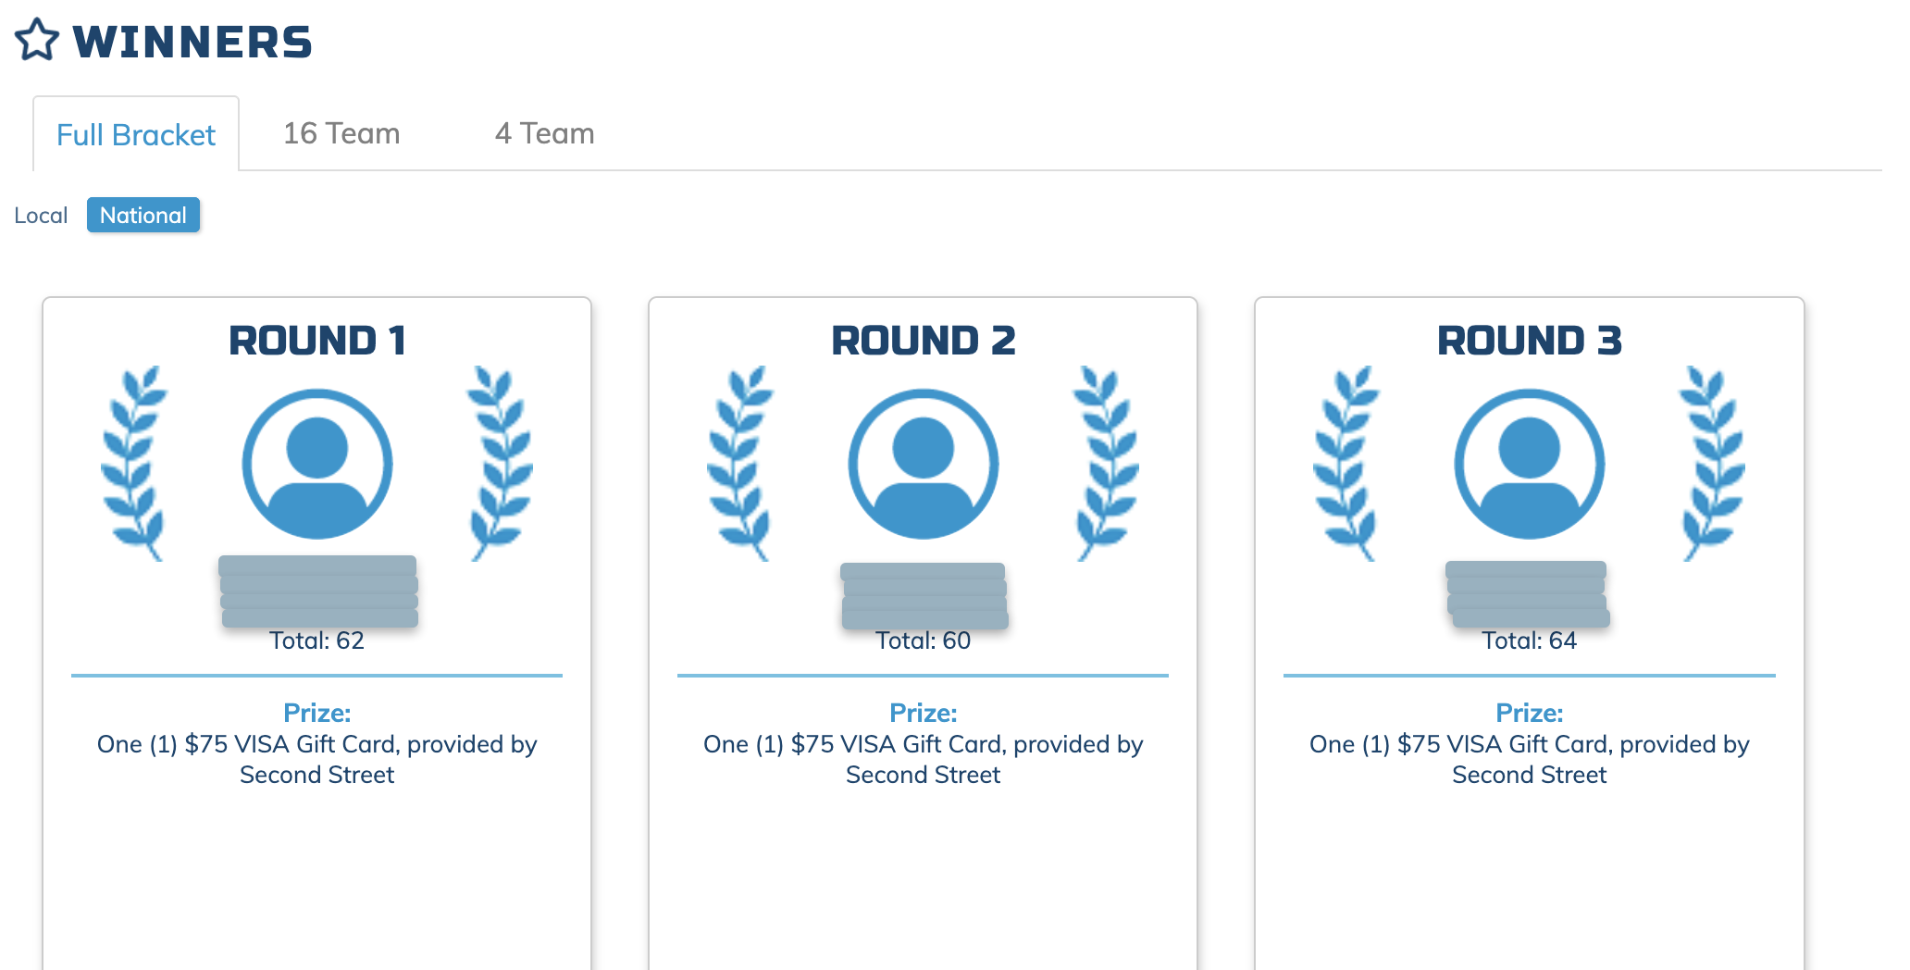
The Prizes
Local Prizes
(provided by Sponsor)
Sponsors can also provide local prizes for the overall 64 Team/16 Team/4 Team Brackets and 6 Rounds to promote their products/services and initiate more participation
National Prizes
(provided by Second Street)
Overall 64 Team/16 Team/4 Team Brackets: $475 Visa gift card
Round winners (6): $75 Visa gift card

Slide 8
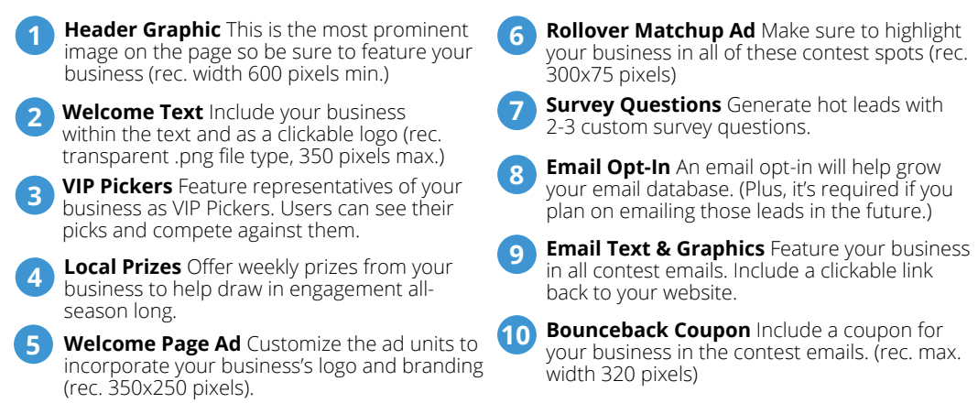
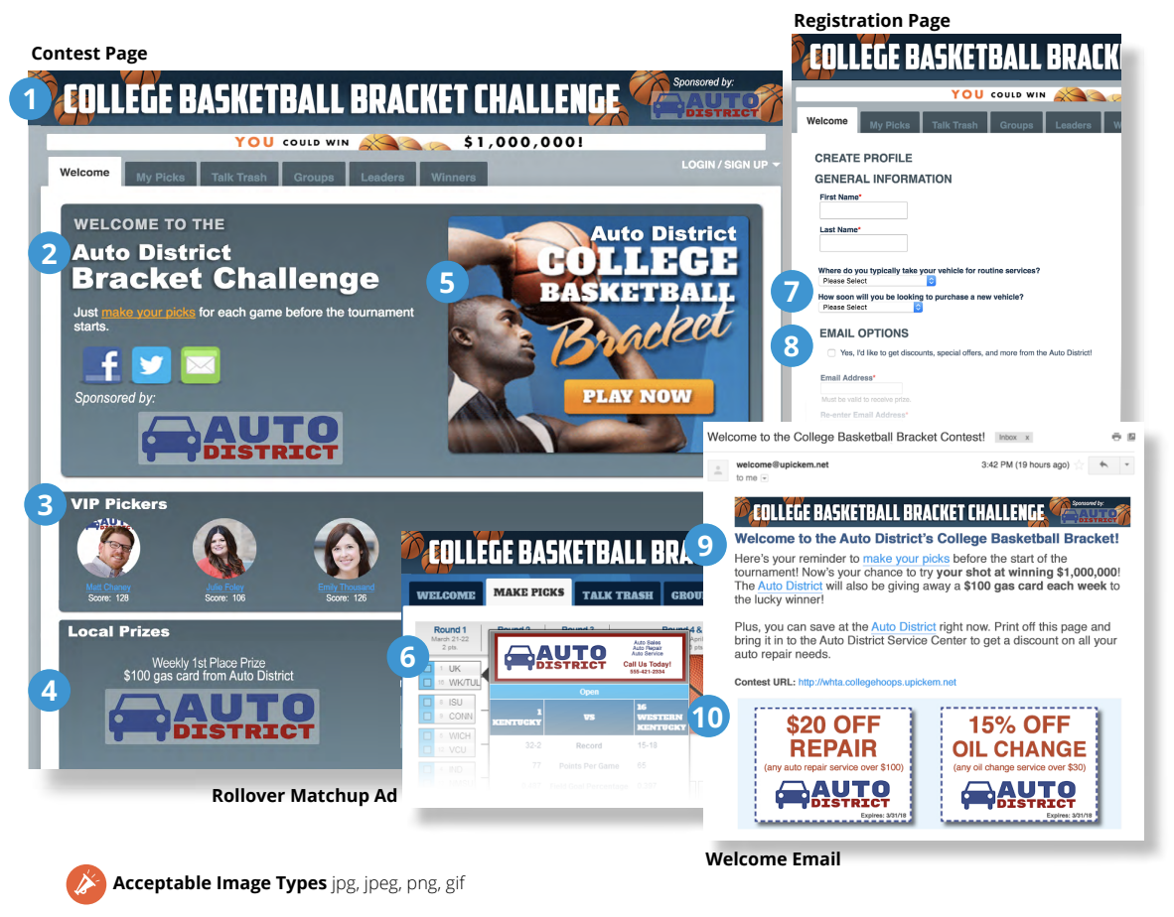
Advertising Opportunities

Slide 9
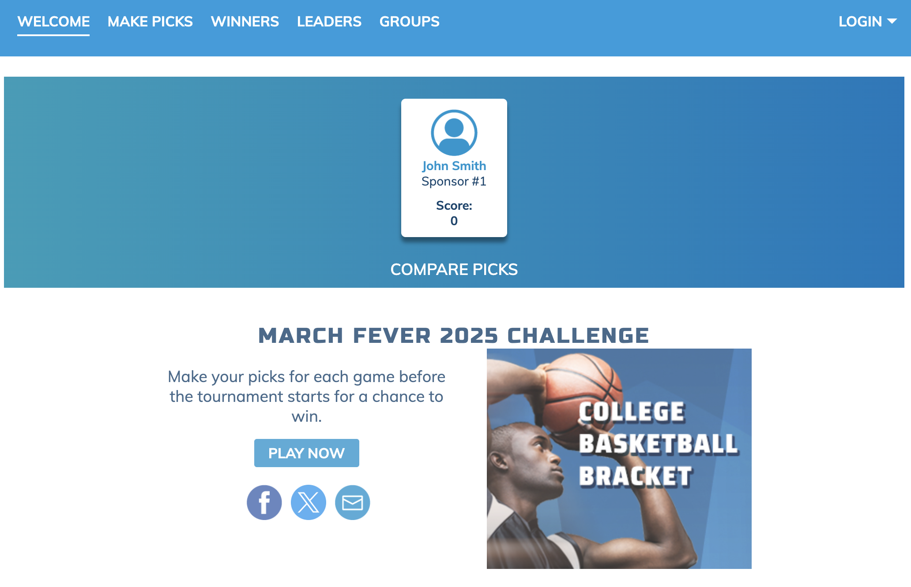
Be a VIP Picker!
Gain further visibility by picking along with the audience! They will be able to see your picks and try to 'beat' your score!

Slide 10
Why Promotions Work
Big Participation
The chance to win motivates thousands to enter
Custom Data
Collect audience preferences and buying intent
Long-Term Value
Build a list that drives sales well beyond the contest
Actionable Leads
Every entry includes an email address
Viral Growth
National interest promotes sharing & multiplies reach
Notes:
Running an online contest is one of the fastest and most effective ways to grow an email database with leads that are ready to act. Here’s why:
Drives Big Participation
People love the chance to win. A great prize instantly gets attention and motivates thousands to enter, giving your brand a huge audience boost.
Collects Real, Actionable Leads
Every entry requires an email address, so you’re not just reaching people once—you’re building a list of potential customers you can market to again and again.
Captures More Than Just Emails
You can ask custom questions that uncover interests, preferences, and buying intent. That means the leads you collect aren’t just names on a list—they’re actionable insights you can use to target future campaigns.
Built-In Word of Mouth
Contests are naturally shareable. When participants spread the word for extra chances to win, your reach multiplies without added cost.
Immediate Impact + Long-Term Value
The contest creates buzz and traffic now, while the email list you build becomes a long-term marketing asset that drives sales well beyond the promotion.
Bottom line: An online contest doesn’t just get attention—it turns that attention into leads you can use to grow revenue.
“An online contest is one of the easiest ways to build a list of people who actually want to hear from you. The prize grabs attention, the entry form collects email addresses and insights about your audience, and the built-in sharing drives viral reach. The best part? You’re not just getting names—you’re building an email list you can market to over and over again, turning one promotion into a long-term revenue driver.”

Slide 11
The Value of Promotions for Your Business
Immediate Impact
Traffic, buzz, and brand awareness
Data-Driven Marketing Insights for smarter targeting and segmentation
Ongoing ROI
A new, engaged email list that can be marketed to over and over

Slide 12
By the Numbers: Cold Leads
Home Services
Average Cold Lead Conversion Rate: 5-10%
(*insert average lead conversion rate of prospect*)
Average Sale: $2,000 (*insert average sale of prospect*)
Potential Leads From Promotion: 200
200 leads x 7% = 14
14 x $2,000 = $28,000
$28,000 in sales from ONE promotion!
Not including:
Opt-ins
Lead-Gen Question Data
Brand Awareness
Notes:
You NEED to look up your advertiser’s industry conversion rates. Different industries will have different conversion rates.
For example:
Home Services: There isn’t a single “correct” average for home improvement lead conversion rates, because it depends heavily on factors like project type, lead source, region, sales process, etc. For newer businesses or those using broader/unqualified lead sources, the conversion might be as low as 5-10%. If the leads are very warm (referrals, repeat customers, very specific projects), conversion can sometimes go above 30-40%.

Slide 13
By the Numbers: Hot Leads
Home Services
Average Hot Lead Conversion Rate: 30-40%
(*insert average lead conversion rate of prospect*)
Average Sale: $2,000 (*insert average sale of prospect*)
Potential Leads From Promotion: 200
200 leads x 35% = 70 Leads Delivered
70 x $2,000 = $140,000
$140,000 in sales from ONE promotion!
Not including:
Opt-ins
Lead-Gen Question Data
Brand Awareness
Lead Generating Promotions
provide you with HOT leads!
Notes:
You NEED to look up your advertiser’s industry conversion rates. Different industries will have different conversion rates.
For example:
Home Services: There isn’t a single “correct” average for home improvement lead conversion rates, because it depends heavily on factors like project type, lead source, region, sales process, etc. For newer businesses or those using broader/unqualified lead sources, the conversion might be as low as 5-10%. If the leads are very warm (referrals, repeat customers, very specific projects), conversion can sometimes go above 30-40%.

Slide 14

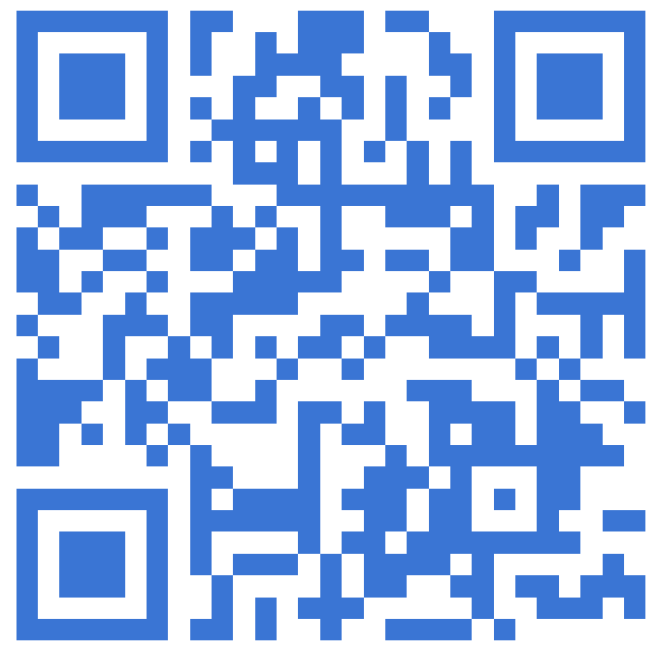
Example Case Study (insert your own!)
Goal:
Local Prize:
Entries:
Lead-Gen Questions:
Sponsor Opt-ins:
Advertiser Feedback:
Revenue:
Insert screenshot of promotion here!
Find more case studies on the Second Street Lab!
Notes:
This is a generic case study template – insert your own case study or visit the Lab!

Slide 15
The Bottom Line The perfect solution for your business
Promotions don’t just get attention—they turn that attention into leads and revenue
One Promotion = Long-Term Marketing Asset
Fun for consumers, powerful for YOU
Notes:
Bottom line: An online contest doesn’t just get attention—it turns that attention into leads you can use to grow revenue.

Slide 16
Let’s get started
Ready to start
growing leads with us
with promotions?
Contact: [Your Name / Company / Email]

Slide 17
Sample Sales Sheets Newspaper

Slide 18

College Basketball Bracket Title Sponsorship Campaign runs 4 weeks
Logo inclusion on all promotional elements for the contest
Digital: Logo included in contest header graphic VIP Picker– pick alongside Sports staff & a local sports celebrity each round Email opt-in on the registration page Up to 3 lead-gen questions on the registration page Opt-in for leads and email database on registration form Contest page 728×90 & 300×250 served together (100% share of voice) Pencil Pushdown (4 times during tournament) 25,000 ROS impressions
Print: Full page contest promotional with QR code to run to run every other week during promotion Half-page contest promotional ad with QR code to run every other week during promotion
Email: 10 promo ads in our Daily Newsletter to database of XXXX 3 Invitation emails sent out each round to promotional database of XXXX Thank You email to all registered entrants Reminder emails to contest players prior to each round (6 total)
Social: Social media post made once per week for length of promotion
Investment for a mid-size market: $5,000 - $10,000

Slide 19
College Basketball Bracket Supporting Sponsorship Campaign runs 4 weeks
Digital: Contest page 300×250 ad VIP Picker– pick alongside Sports staff & a local sports celebrity each round
Print: Logo included on ¼ page contest promotional ad with QR code to run to run every other week during promotion
Email: Logo included in 3 Invitation emails sent each round to promotional database of XXXX Logo included in Thank You email to all registered entrants Logo included in Reminder emails to contest players prior to each round (6 total)
Investment for a mid-size market: $1,000 - $2,000

Slide 20
Sample Sales Sheets Magazine

Slide 21
College Basketball Bracket Title Sponsorship Campaign runs 4 weeks
Logo inclusion on all promotional elements for the contest
Digital: Logo included in contest header graphic VIP Picker– pick alongside Sports staff & a local sports celebrity each round Email opt-in on the registration page Up to 3 lead-gen questions on the registration page Opt-in for leads and email database on registration form Contest page 728×90 & 300×250 served together (100% share of voice) Pencil Pushdown (4 times during tournament) 25,000 ROS impressions
Print: Full-page promotional ad [# of months contest is running] monthly premium full-color ads
Email: 10 promo ads in our Daily Newsletter to database of XXXX 3 Invitation emails sent out each round to promotional database of XXXX Thank You email to all registered entrants Reminder emails to contest players prior to each round (6 total)
Social: Social media post made once per week for length of promotion
Investment for a mid-size market: $5,000 - $10,000

Slide 22
College Basketball Bracket Supporting Sponsorship Campaign runs 4 weeks
Digital: Contest page 300×250 ad VIP Picker– pick alongside Sports staff & a local sports celebrity each round
Print: ¼ page promotional ad [# of months contest is running] monthly full-color ads
Email: Logo included in 3 Invitation emails sent each round to promotional database of XXXX Logo included in Thank You email to all registered entrants Logo included in Reminder emails to contest players prior to each round (6 total)
Investment for a mid-size market: $1,000 - $2,000

Slide 23
Sample Sales Sheets TV

Slide 24
College Basketball Bracket Title Sponsorship Campaign runs 4 weeks
Logo inclusion on all promotional elements for the contest
Digital: Logo included in contest header graphic VIP Picker– pick alongside Sports staff & a local sports celebrity each round Email opt-in on the registration page Up to 3 lead-gen questions on the registration page Opt-in for leads and email database on registration form Contest page 728×90 & 300×250 served together (100% share of voice) Pencil Pushdown (4 times during tournament) 25,000 ROS impressions
TV: Sportscaster to mention contest & sponsor nightly during basketball score recaps Audio/video ID in :30 shared promotional spots, Mon-Fri, 6a-12a (minimum 15/week) Audio/video ID in :15 reminder shared promo spots, Saturday, 6a-12a (5/week)
Email: 10 promo ads in our Daily Newsletter to database of XXXX 3 Invitation emails sent out each round to promotional database of XXXX Thank You email to all registered entrants Reminder emails to contest players prior to each round (6 total)
Social: Social media post made once per week for length of promotion
Investment for a mid-size market: $5,000 - $10,000

Slide 25
College Basketball Bracket Supporting Sponsorship Campaign runs 4 weeks
Digital: Contest page 300×250 ad VIP Picker– pick alongside Sports staff & a local sports celebrity each round
TV: Video ID in :30 shared promotional spots, Mon-Fri, 6a-12a (minimum 15/week) Video ID in :15 reminder shared promo spots, Saturday, 6a-12a (5/week)
Email: Logo included in 3 Invitation emails sent each round to promotional database of XXXX Logo included in Thank You email to all registered entrants Logo included in Reminder emails to contest players prior to each round (6 total)
Investment for a mid-size market: $1,000 - $2,000

Slide 26
Sample Sales Sheets Radio

Slide 27
College Basketball Bracket Title Sponsorship Campaign runs 4 weeks
Logo inclusion on all promotional elements for the contest
Digital: Logo included in contest header graphic VIP Picker– pick alongside Sports staff & a local sports celebrity each round Email opt-in on the registration page Up to 3 lead-gen questions on the registration page Opt-in for leads and email database on registration form Contest page 728×90 & 300×250 served together (100% share of voice) Pencil Pushdown (4 times during tournament) 25,000 ROS impressions
Radio: Minimum of 55x :30 promotional spots each week (M-F 6a-7p, Sa-Su 8a-4p) Minimum of 90x :30 streaming promo spots each week (M-F 6a-7p, Sa-Su 8a-4p) 20x :30 on-air commercials each week (M-F 6a-7p)
Email: 10 promo ads in our Daily Newsletter to database of XXXX 3 Invitation emails sent out each round to promotional database of XXXX Thank You email to all registered entrants Reminder emails to contest players prior to each round (6 total)
Social: Social media post made once per week for length of promotion
Investment for a mid-size market: $5,000 - $10,000

Slide 28
College Basketball Bracket Supporting Sponsorship Campaign runs 4 weeks
Digital: Contest page 300×250 ad VIP Picker– pick alongside Sports staff & a local sports celebrity each round
Radio: Minimum of 25x :30 promotional spots each week (M-F 6a-7p, Sa-Su 8a-4p) Minimum of 45x :30 streaming promo spots each week (M-F 6a-7p, Sa-Su 8a-4p) 10x :30 on-air commercials each week (M-F 6a-7p)
Email: Logo included in 3 Invitation emails sent each round to promotional database of XXXX Logo included in Thank You email to all registered entrants Logo included in Reminder emails to contest players prior to each round (6 total)
Investment for a mid-size market: $1,000 - $2,000

Slide 29
Our Reach
Promotions List Size:
Avg Ad Click-Thru Rate:
Circulation/
Viewership/
Listenership
Daily Newsletter List Size:
Unique Site Visitors:
XXX
XXX
XXX
XXX
XXX
Avg # of Sweepstakes Entries
Avg # of Leads Generated
XXX
XXX
Notes:
Fill in your stats and feel free to place elsewhere in the deck

Slide 30
Our Demos
Male
XX%
Female
XX%
Age Ranges
Average HHI
$XXX
Notes:
Fill in your stats and feel free to place elsewhere in the deck

Slide 31

Name Job Title Business Name
Quote from happy advertiser

Slide 32




Let’s get started
Today
Needs Assessment
Creative Sign-Off
Launch
Follow Up
Aligning your goals with this promotion campaign
Review and approve creative material for campaign
Kick off of your campaign! We will review results at 30, 60 and 90 days post kick off to promote the success of your campaign.
At the end of the campaign, we will follow up with all results and data.

Slide 33




Our dedicated team of advertising strategists
First Last
First Last
First Last
First Last
Media & Digital Marketing Guru
Media Promotions & Sales Maverick
Publishing & Broadcasting Brainiac
Content & Promotions Powerhouse

