Slide 1
Radio

Slide 2
Best of the Best Title Sponsorship
Your
Logo
Here
We are highlighting the best of the best. Our readers will nominate their favorite businesses in our community and the vote for they businesses they’d like to see win. Use this package with exclusive advertising opportunities to promote your business.
Important Dates:
Nomination Round: Enter Dates Here
Voting Round: Enter Dates Here
Winners Announced: Enter Dates Here
Audience Stats
Nominations:
Votes:
Users
Page Views:
Digital:
Leaderboard ad on ballot landing page
Logo on all Best Of promotional ads
Up to 3 Group sponsor ad
Up to 10 Category sponsor ads
1 Exclusive Groups Page ad
2 Category Interstitial ads
Unlimited Featured Entrants
Mobile
Up to 10 keywords used to capture votes via text
Radio:
Minimum of 80x :30 promotional spots weekly (M-F 6a-7p, Sat-Sun 8a-4p)
Minimum of 120x :30 streaming promotional spots weekly (M-F 6a-7p, Sat-Sun 8a-4p)
Your business mentioned in any on-air spots related to the program
Email:
Banner ads in all newsletters sent during nomination, voting, and winner’s rounds
Special offer or custom message in all Thank You emails
Your logo on all invitation emails to promotional list during nomination, voting, and winners’ rounds
Event (optional)
Logo on photo backdrop banner (step and repeat)
Two-minute recognition speech at introduction of event
Logo on event signage
INVESTMENT: $22,000
Value: $35,000
For more information, contact your Account Representative or call 000.000.0000
Notes:
**If you sell a Title Sponsor, you need to remove the Groups Page Ad option from other packages, as Title Sponsor should have that ad spot exclusively.

Slide 3
Best of the Best Nomination Packages
Your
Logo
Here
We are highlighting the best of the best. Our readers will nominate their favorite businesses in our community to tell us who they want to see in the voting round. To promote your business, we have created 3 promotional packages.
Important Dates:
Nomination Round: Enter Dates Here
Voting Round: Enter Dates Here
Winners Announced: Enter Dates Here
Audience Stats
Nominations:
Votes:
Users
Page Views:
Basic Package
Campaign runs for 4 weeks
Digital:
1 Category sponsor ad
300x 250 ad on ballot page
Mobile
1 keyword used to capture votes via text
Deluxe Package
Campaign runs for 4 weeks
Digital:
Up to 3 Category sponsor ads
300x 250 ad on ballot page
Mobile
Up to 3 keywords used to capture votes via text
Radio:
Minimum of 40x :30 promotional spots weekly (M-F 6a-7p, Sat-Sun 8a-4p)
Minimum of 60x :30 streaming promotional spots weekly (M-F 6a-7p, Sat-Sun 8a-4p)
Premium Package
Campaign runs for 4 weeks
Digital:
1 Group sponsor ad
Up to 5 Category sponsor ads
1 Groups Page ad (Ballot home page)
1 Category Interstitial ad
300x 250 ad on ballot page
Mobile
Up to 5 keywords used to capture votes via text
Radio:
Minimum of 80x :30 promotional spots weekly (M-F 6a-7p, Sat-Sun 8a-4p)
Minimum of 120x :30 streaming promotional spots weekly (M-F 6a-7p, Sat-Sun 8a-4p)
Email:
"Nominate Us" ad in Daily Headlines Newsletter 1x during nomination round
Your logo on invitation email to our promotional list 1x during nomination round
YES, I’M INTERESTED IN ADVERTISING
IN THE
VOTING ROUND
INVESTMENT: $699
INVESTMENT: $1,200
INVESTMENT: $2,000
For more information, contact your Account Representative or call 000.000.0000
Notes:
Update this sales sheet with stats from last year’s Best Of! Be sure to include any percentage increases as well – they can really make an impact!

Slide 4
Pick Your Categories & Campaign to Win
Arts & Entertainment
Attraction
Art Gallery
Cultural Event
Dance Club
Entertainment Venue
Family Entertainment
Festival
Fundraising Event
Live Music Event
Live Theater Group
Local Band
Local Casino
Local Event
Movie Theater
Museum
Musician
Nightclub
Outdoor Event
Place for Kids’ Birthday Party
Eating & Drinking
24-Hour Restaurant
Bagels
Bakery
Barbeque Restaurant
Bartender (Name & Place)
Bed & Breakfast
Beer Selection
Breakfast
Brunch
Buffet Restaurant
Catering
Chef (Name & Place)
Chicken Wings
Chinese Restaurant
Coffeehouse
Deli
Dive Bar
Donuts
Food Truck
French Fries
Fried Chicken
Hamburger
Happy Hour
Indian Restaurant
Italian Restaurant
Japanese Restaurant
Kid-Friendly Restaurant
Margarita
Mexican Restaurant
Romantic Restaurant
Outdoor Patio
Pizza
Seafood Restaurant
Soul Food
Sports Bar
Steakhouse
Take Out
Thai/Vietnamese Restaurant
Upscale Bar
Vegetarian Restaurant
Wine Selection
Winery
Health & Fitness
Acupuncturist
Assisted Living Facility
Audiologist
Chiropractor
Clinic
Cosmetic Dermatologist
Cosmetic Surgeon
Day Spa
Dentist
Dermatologist
Eye Clinic
Hospital
In-Home Care Elder Services
Laser Eye Center
Massage
Massage Therapist
Medical Group
Medical Spa
Orthodontist
Pediatrician
Personal Trainer
Pharmacy
Physician
Weight Loss Clinic/Counseling
Services
Accounting Firm
Auto Loan Provider
Bank
Bookkeeping/Tax Service
Car Wash
Carpet Cleaner
Child Care
Commercial Real Estate
Computer/IT Services
Construction Company
Contractor
Financial Institution
Financial Planning
Hair Salon
Heating & Air Company
Home Lighting
Home Security
Hotel
Insurance Agency
Jeweler
Kitchen & Bath Remodeler
Landscaper
Law Firm/Lawyer
Mechanic
Mortgage/Home Loan Provider
Motorcycle Shop
Nail Salon
New Home Builder
Oil Change
Pest Control
Pet Boarding/Daycare
Pet Groomer
Photographer
Piercing Studio
Plumber
Property Management Company
Real Estate Agency
Real Estate Agent
Shoe Repair Store
Tanning Salon
Tire Shop
Travel Agent
Veterinarian
Sports & Recreation
Bowling Alley
Driving Range
Golf Course
Gym
Health & Fitness Club
Local Park
Pilates Studio
Pool Hall
Shooting Range
Swimming Pool/Waterpark
Yoga Studio
Shopping
Antique Store
Appliance Store
Bicycle Shop
Book Store
Boutique
Bridal/Formal Wear
Children’s Clothing Store
Consignment Store
Department Store
Flooring/Carpet Store
Florist
Garden Store/Nursery
Gift Store
Golf Shop
Grocery Store
Health Food Store
Home Electronics Store
Home Furnishing Store
Home Improvement Store
Liquor Store
Mall/Shopping Center
Mattress Store
Men’s Clothing Store
Outdoor Outfitters
Place to Buy a Used Car
Show Store
Sporting Goods Store
Thrift Store
Toy Store
Women’s Clothing Store
Local
Church
Community Activist
Local Actor
Local Actress
Local Athlete
Local Author
Local Cause
Local Clothing Designer
Local Hero
Local Legislator
Local Radio Personality
Local Sports Team
Local Talk Show Host
Local Television Personality
Local Twitter Feed
Local Website/Blog
Neighborhood
Philanthropist
Place to Get Married
Place to Take Out of Town Guest
Place to Work
Scenic Spot
Staycation Location
Place QR Code Here!
Scan this QR code to access complimentary materials to promote your business during the nomination round, including social media graphics and marketing tips.
Make sure these materials are placed behind a form, so you are collecting advertiser information and opt-ins!
Notes:
Place your QR code on this page. Make sure these materials are placed behind a form, so you are collecting advertiser information and opt-ins!

Slide 5
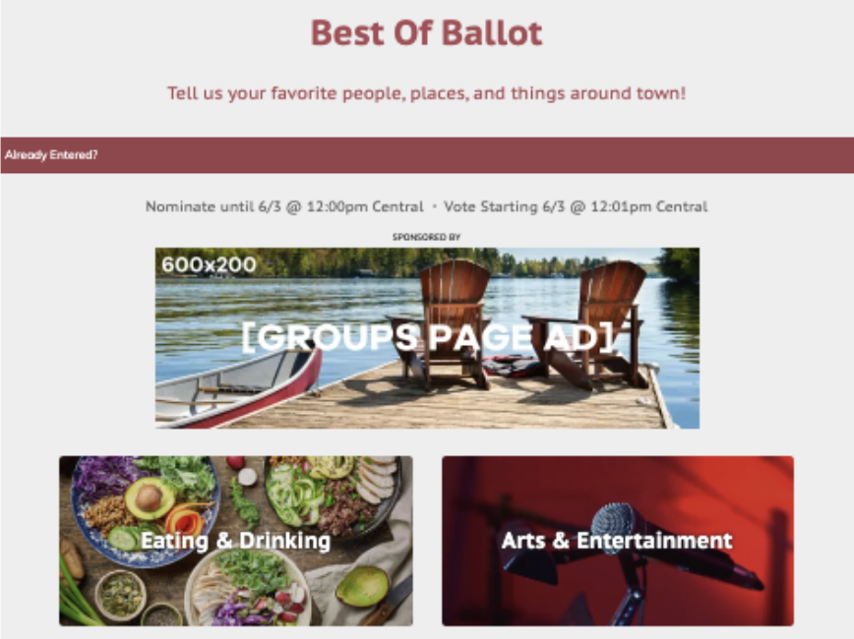
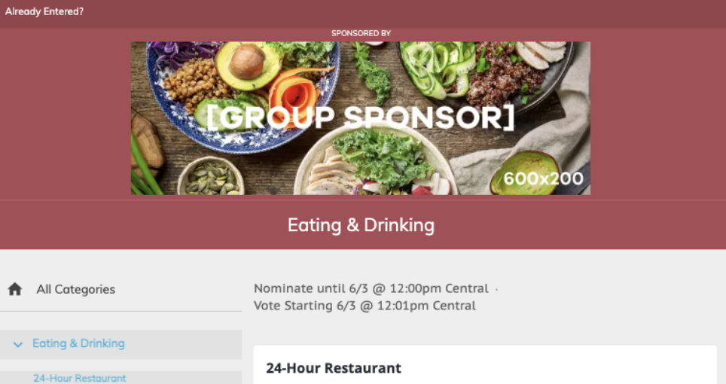
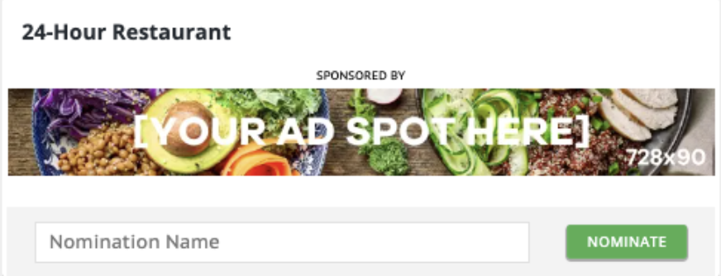
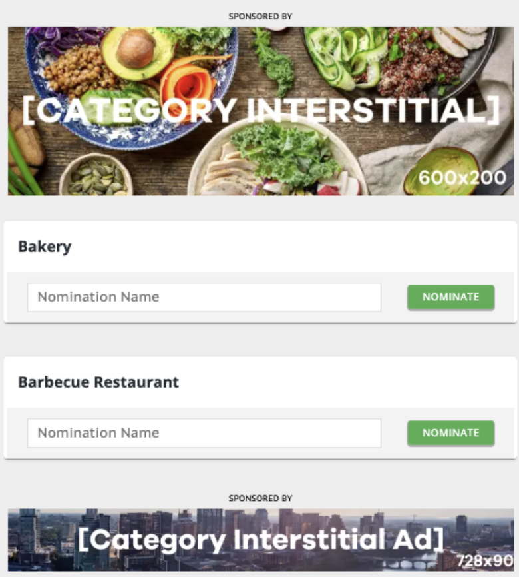
Group and Category Ad Examples & Specs
Groups Page Ad
Desktop: 600px x 200px/728px x 90px
Mobile: 320px x 50px
Appears above the Group Images on the Groups page
Group Sponsor Ad
Desktop: 600px x 200px/728px x 90px
Mobile: 320px x 50px
Category Sponsor Ad
Desktop: 600px x 200px/728px x 90px
Mobile: 320px x 50px
Category Interstitial Ad
Desktop: 600px x 200px/728px x 90px
Mobile: 320px x 50px
Appears in between categories. You can set the frequency

Slide 6
Best of the Best Voting Packages
Your
Logo
Here
We are highlighting the best of the best. Our readers will vote for their favorite businesses in our community to tell us who they want to see in win. To promote your business, we have created 3 promotional packages.
Important Dates:
Nomination Round: Enter Dates Here
Voting Round: Enter Dates Here
Winners Announced: Enter Dates Here
Audience Stats
Nominations:
Votes:
Users
Page Views:
Basic Package
Campaign runs for 3 weeks
Digital:
1 Category sponsor ad w/ link to Entrant Page
1 Featured Entrant ballot listing
Featured Entrant Page including:
300x 250 ad on ballot page w/ link to Entrant Page
Mobile
1 keyword used to capture votes via text
Deluxe Package
Campaign runs for 3 weeks
Digital:
Up to 3 Category sponsor ads w/ link to Entrant Page
Up to 3 Featured Entrant ballot listings
Featured Entrant Page including:
300x 250 ad on ballot page
Mobile
Up to 3 keywords used to capture votes via text
Radio:
Minimum of 40x :30 promotional spots weekly (M-F 6a-7p, Sat-Sun 8a-4p)
Minimum of 60x :30 streaming promotional spots weekly (M-F 6a-7p, Sat-Sun 8a-4p)
Premium Package
Campaign runs for 3 weeks
Digital:
1 Groups Page ad (Ballot home page)
1 Group sponsorship
1 Category Interstitial ad
Up to 5 Category sponsor ads w/ link to Entrant Page
Up to 5 Featured Entrant ballot listings
Featured Entrant Page (see Deluxe package for details)
300x 250 ad on ballot page
Mobile
Up to 5 keywords used to capture votes via text
Radio:
Minimum of 80x :30 promotional spots weekly (M-F 6a-7p, Sat-Sun 8a-4p)
Minimum of 120x :30 streaming promotional spots weekly (M-F 6a-7p, Sat-Sun 8a-4p)
Email:
"Vote for Us" ad in Daily Headlines Newsletter 1x during voting round
Your logo on "Time to Vote" email to our promotional list 1x during voting round
Unique URL
728x90 Entrant Page Ad
Prevalent Vote/Share Buttons
Entrant Main Image/Video
Entrant Logo
Google Maps & Multiple Locations
Entrant Page Image Gallery
Description, Phone #, Website, Social Links
Vote in Other Categories
Unique URL
728x90 Entrant Page Ad
Prevalent Vote/Share Buttons
Entrant Main Image/Video
Entrant Logo
Google Maps & Multiple Locations
Entrant Page Image Gallery
Description, Phone #, Website, Social Links
YES, I’M INTERESTED IN ADVERTISING
IN THE
WINNERS’ ROUND
INVESTMENT: $999
INVESTMENT: $1,500
INVESTMENT: $2,350
For more information, contact your Account Representative or call 000.000.0000
Notes:
Update this sales sheet with stats from last year’s Best Of! Be sure to include any percentage increases as well – they can really make an impact!

Slide 7
Pick Your Categories & Campaign to Win
Arts & Entertainment
Attraction
Art Gallery
Cultural Event
Dance Club
Entertainment Venue
Family Entertainment
Festival
Fundraising Event
Live Music Event
Live Theater Group
Local Band
Local Casino
Local Event
Movie Theater
Museum
Musician
Nightclub
Outdoor Event
Place for Kids’ Birthday Party
Eating & Drinking
24-Hour Restaurant
Bagels
Bakery
Barbeque Restaurant
Bartender (Name & Place)
Bed & Breakfast
Beer Selection
Breakfast
Brunch
Buffet Restaurant
Catering
Chef (Name & Place)
Chicken Wings
Chinese Restaurant
Coffeehouse
Deli
Dive Bar
Donuts
Food Truck
French Fries
Fried Chicken
Hamburger
Happy Hour
Indian Restaurant
Italian Restaurant
Japanese Restaurant
Kid-Friendly Restaurant
Margarita
Mexican Restaurant
Romantic Restaurant
Outdoor Patio
Pizza
Seafood Restaurant
Soul Food
Sports Bar
Steakhouse
Take Out
Thai/Vietnamese Restaurant
Upscale Bar
Vegetarian Restaurant
Wine Selection
Winery
Health & Fitness
Acupuncturist
Assisted Living Facility
Audiologist
Chiropractor
Clinic
Cosmetic Dermatologist
Cosmetic Surgeon
Day Spa
Dentist
Dermatologist
Eye Clinic
Hospital
In-Home Care Elder Services
Laser Eye Center
Massage
Massage Therapist
Medical Group
Medical Spa
Orthodontist
Pediatrician
Personal Trainer
Pharmacy
Physician
Weight Loss Clinic/Counseling
Services
Accounting Firm
Auto Loan Provider
Bank
Bookkeeping/Tax Service
Car Wash
Carpet Cleaner
Child Care
Commercial Real Estate
Computer/IT Services
Construction Company
Contractor
Financial Institution
Financial Planning
Hair Salon
Heating & Air Company
Home Lighting
Home Security
Hotel
Insurance Agency
Jeweler
Kitchen & Bath Remodeler
Landscaper
Law Firm/Lawyer
Mechanic
Mortgage/Home Loan Provider
Motorcycle Shop
Nail Salon
New Home Builder
Oil Change
Pest Control
Pet Boarding/Daycare
Pet Groomer
Photographer
Piercing Studio
Plumber
Property Management Company
Real Estate Agency
Real Estate Agent
Shoe Repair Store
Tanning Salon
Tire Shop
Travel Agent
Veterinarian
Sports & Recreation
Bowling Alley
Driving Range
Golf Course
Gym
Health & Fitness Club
Local Park
Pilates Studio
Pool Hall
Shooting Range
Swimming Pool/Waterpark
Yoga Studio
Shopping
Antique Store
Appliance Store
Bicycle Shop
Book Store
Boutique
Bridal/Formal Wear
Children’s Clothing Store
Consignment Store
Department Store
Flooring/Carpet Store
Florist
Garden Store/Nursery
Gift Store
Golf Shop
Grocery Store
Health Food Store
Home Electronics Store
Home Furnishing Store
Home Improvement Store
Liquor Store
Mall/Shopping Center
Mattress Store
Men’s Clothing Store
Outdoor Outfitters
Place to Buy a Used Car
Show Store
Sporting Goods Store
Thrift Store
Toy Store
Women’s Clothing Store
Local
Church
Community Activist
Local Actor
Local Actress
Local Athlete
Local Author
Local Cause
Local Clothing Designer
Local Hero
Local Legislator
Local Radio Personality
Local Sports Team
Local Talk Show Host
Local Television Personality
Local Twitter Feed
Local Website/Blog
Neighborhood
Philanthropist
Place to Get Married
Place to Take Out of Town Guest
Place to Work
Scenic Spot
Staycation Location
Place QR Code Here!
Scan this QR code to access complimentary materials to promote your business during the voting round, including social media graphics and marketing tips.
Make sure these materials are placed behind a form, so you are collecting advertiser information and opt-ins!

Slide 8
Group and Category Ad Examples & Specs
Groups Page Ad
Desktop: 600px x 200px/728px x 90px
Mobile: 320px x 50px
Appears above the Group Images on the Groups page
Group Sponsor Ad
Desktop: 600px x 200px/728px x 90px
Mobile: 320px x 50px
Category Sponsor Ad
Desktop: 600px x 200px/728px x 90px
Mobile: 320px x 50px
Category Interstitial Ad
Desktop: 600px x 200px/728px x 90px
Mobile: 320px x 50px
Appears in between categories. You can set the frequency

Slide 9
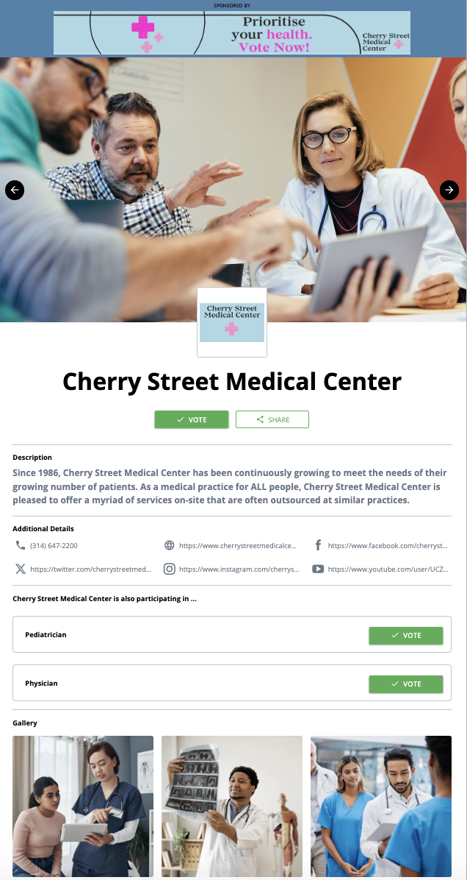
Featured Entrant Image Examples & Specs
Entrant Page Ad
Desktop: 600px x 200px/728px x 90px
Mobile: 320px x 50px
Entrant Main Image/Video
2560px x 1440px
Entrant Logo
400px x 400px
Entrant Page Image Gallery
500px x 500px

Slide 10
Best of the Best Winners’ Packages
Your
Logo
Here
We are are celebrating the best of the best! Our readers nominated and voted on their favorite businesses in our community. To promote your business and thank our readers, we have created 3 promotional packages for the prestigious winners’ round!
Current Years’ Audience Stats
Nominations:
Votes:
Users
Page Views:
Important Dates:
Winners Announced: Enter Dates Here
Winners Event: Enter Dates Here
Basic Package
Digital:
1 Category sponsor ad on the Winners’ Directory
1 Featured Entrant ballot listing
Featured Entrant Page including:
300x 250 ad on Winners’ Directory
Print:
Quarter–page full color glossy “Thank You” ad in our special issue
Deluxe Package
Digital:
Up to 3 Category sponsor ads w/ link to Entrant Page in Winners’ Directory
Up to 3 Featured Entrant ballot listings
Featured Entrant Page including:
300x 250 ad on Winners’ Directory
Radio:
Minimum of 40x :30 promotional spots (M-F 6a-7p, Sat-Sun 8a-4p)
Minimum of 60x :30 streaming promotional spots (M-F 6a-7p, Sat-Sun 8a-4p)
Premium Package
Digital:
1 Groups Page ad (Ballot home page)
1 Group sponsorship
1 Category Interstitial ad
Up to 5 Category sponsor ads w/ link to Entrant Page on Winners’ Directory
Up to 5 Featured Entrant ballot listings
Featured Entrant Page inducing:
300x 250 ad on ballot page
Radio:
Minimum of 80x :30 promotional spots (M-F 6a-7p, Sat-Sun 8a-4p)
Minimum of 120x :30 streaming promotional spots (M-F 6a-7p, Sat-Sun 8a-4p)
Email:
"Thank You" ad in Daily Headlines Newsletter 1x after winners are chosen
Your logo on Winner Announcement email to our promotional list 1x after Winners are chosen
Unique URL
Prevalent Vote/Share Buttons
728x90 Entrant Page Ad
Entrant Main Image/Video
Entrant Logo
Google Maps & Multiple Locations
Entrant Page Image Gallery
Description, Phone #, Website, Social Links
Unique URL
Prevalent Vote/Share Buttons
728x 90 Entrant Page Ad
Entrant Main Image/Video
Entrant Logo
Google Maps & Multiple Locations
Entrant Page Image Gallery
Description, Phone #, Website, Social Links
Unique URL
Prevalent Vote/Share Buttons
728x 90 Entrant Page Ad
Entrant Main Image/Video
Entrant Logo
Google Maps & Multiple Locations
Entrant Page Image Gallery
Description, Phone #, Website, Social Links
INVESTMENT: $999
INVESTMENT: $1,499
INVESTMENT: $1,999
For more information, contact your Account Representative or call 000.000.0000

Slide 11
Group and Category Ad Examples & Specs
Groups Page Ad
Desktop: 600px x 200px/728px x 90px
Mobile: 320px x 50px
Appears above the Group Images on the Groups page
Group Sponsor Ad
Desktop: 600px x 200px/728px x 90px
Mobile: 320px x 50px
Category Sponsor Ad
Desktop: 600px x 200px/728px x 90px
Mobile: 320px x 50px
Category Interstitial Ad
Desktop: 600px x 200px/728px x 90px
Mobile: 320px x 50px
Appears in between categories. You can set the frequency

Slide 12
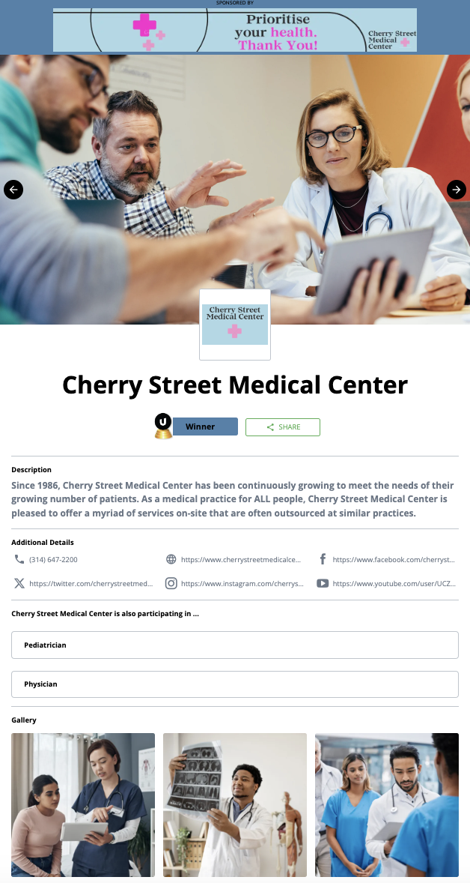
Featured Entrant Image Examples & Specs
Entrant Page Ad
Desktop: 600px x 200px/728px x 90px
Mobile: 320px x 50px
Entrant Main Image/Video
2560px x 1440px
Entrant Logo
400px x 400px
Entrant Page Image Gallery
500px x 500px

